Slide 1
BSAC Sports Diver Training
Going Diving

Slide 2
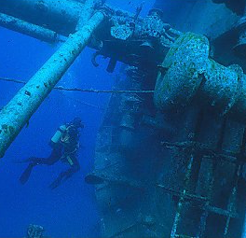
Going Diving as a Sport Diver
Aims
Enjoying diving
  A broader variety of diving and buddies
  Dive leading
  Considering personal limitations
  Introduction to Rebreather diving
  Play a wider role during diving activities and assist the Dive Manager
  What next?

Slide 3
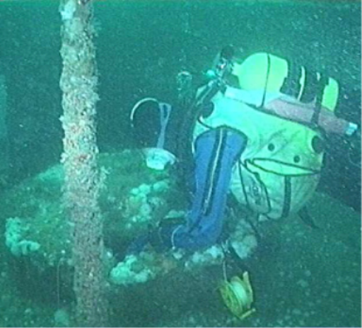
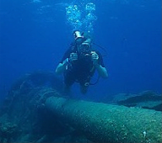
Experienced Buddies
Experienced buddies pass on their experience:
  In extending diving range
  Helping to develop equipment configurations
  Helping with practice of techniques for different types of dives
  Increasing overall awareness of diving conditions
Develop particular interests
  Wreck, reef diving
  Marine life identification
  Photography

Slide 4
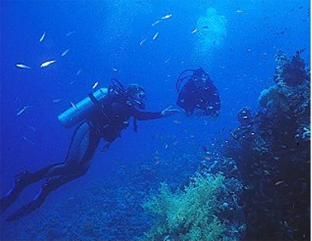
Dive Leading
Equally experienced buddy
Less experienced buddy
  Qualification level
  Type of conditions
You become a role model
Pass on good practice
  General conduct
  Self assessment
  Dive planning and monitoring

Slide 5

Dive Leading - Planning
Self & Buddy risk assessment
Conditions
  Suitable for level of experience
Depth
  Within previous experience
Breathing Gas
  Adequate supply and back up for type of dive
Equipment
  Buddy check
  Practiced?
  Conditions
  Depth
  Breathing Gas
  Equipment

Slide 6
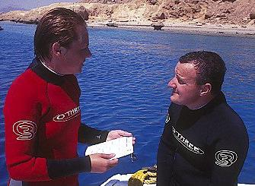
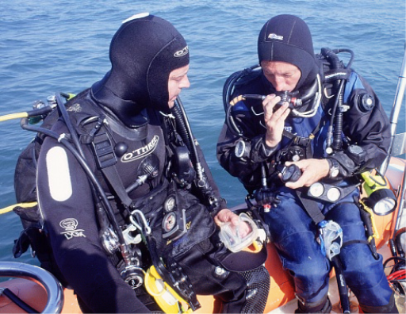
Dive Leading - the Brief
Clear Brief - SEEDS
  Safety
    Fit to dive
    Underwater hazards
  Exercise/Dive Objective
    Depth, Time, Breathing Gas
  Equipment
    Buddy Check
    Other equipment for the dive
  Discipline on the dive
    Positioning, particularly when equipment being deployed
  Signals
    Normal and any special ones

Slide 7
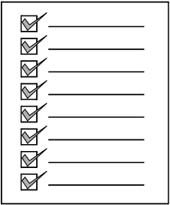
Dive Leading - the Brief
The Dive Manager’s Checklist

Slide 8
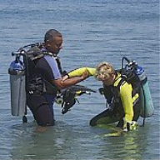
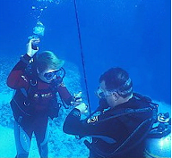
Dive Leading - the Dive
Making the dive a safe and enjoyable experience
  Assisting on kit up and entry
  Monitoring
    Depth, time and breathing gas
    Self and buddy reactions
  Points of interest
  Assisting on exit, de-kit
  Debriefing the experience
  Recording the dive
    Signing logbooks
    Details to the Dive Manager

Slide 9
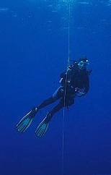
Dive Leading = Role model
Equipment
  Task loading
  Practised in use
  Buoyancy trimmed
  Tidy, neat stowage
Underwater deployment
  Involve buddy when appropriate

Slide 10
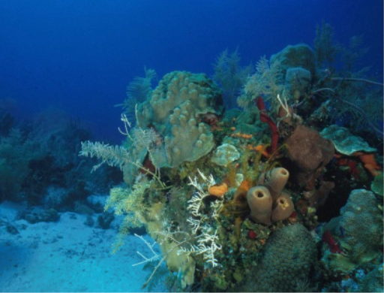

Role Model - Protection of the Environment
Reef Conservation
  Buoyancy and finning
  Look but don’t touch
Wreck Protection
  Look but don’t remove
  Report recovered finds to the Receiver of Wreck
  Report finds of interest or concern to the Receiver of Wreck

Slide 11
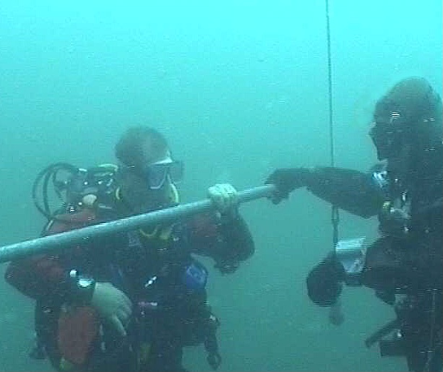
Personal Limits
  Your own comfort factor to enjoy diving
    Do the type of diving you want to do
    Avoid pressures to extend experience or depth too quickly
    Challenge of diving tempered by being prepared for the challenge
    Don’t rush - gradually consolidate experience

Slide 12
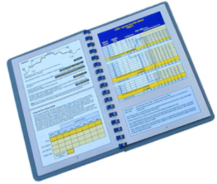
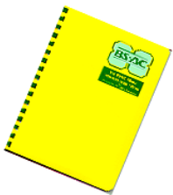
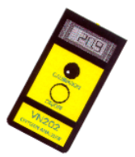
Nitrox for Sports Divers
Do not exceed the MOD of any gas
    includes gas carried for decompression
Exception for NO-STOP Dives Only
    Nitrox 32 can be used to 35 metres
    Nitrox 36 can be used to 30 metres
Equipment
  Cylinders labelled with gas % and MOD
Dive Planning
  Plan for MOD of Nitrox diver and dive time of air (21%O₂) diver
  All other procedures the same

Slide 13
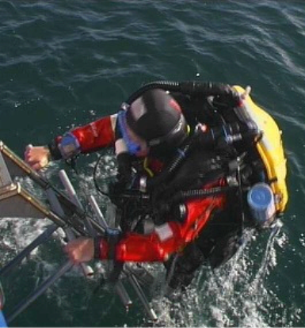
Rebreather Divers
Rebreathers
  What are Rebreathers
  Buddy considerations when diving with Rebreather divers

Slide 14
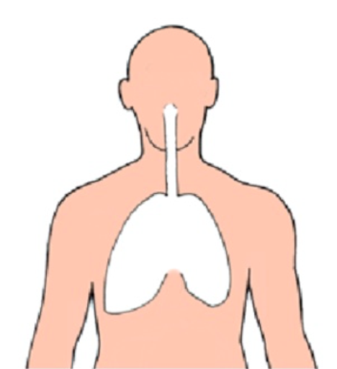

What is a Rebreather
  A continuous breathing loop
Mouthpiece
  Divers lungs and mouthpiece
Counter-lungs
  Breathing bags (counter-lungs)
  Recycles gas through ‘ loop’ using one way valves to maintain gas flow
Gas Cylinder
  Carbon dioxide (CO₂) removal - absorbent or ‘scrubber’ canister
  Requires small gas supply connected into loop to replenish oxygen consumed by respiration
Absorbent canister (the scrubber)
    Delivers nitrox mixes

Slide 15
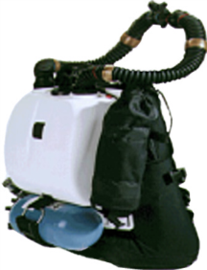
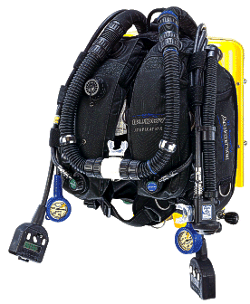
Types of Rebreather
  Semi-closed Circuit Rebreather (SCR)
      Cylinder of pre-selected gas mix
      Maximum operating depth (MOD) determined by mix being used
      Excess gas vented off periodically, bubbles
  Closed Circuit Rebreather (CCR)
      2 cylinders, oxygen and air
      Electronically controlled - optimum Nitrox mix to depth
      No bubbles, except for venting on ascent
  Both systems should have an adequate bailout that can be used as an AS

Slide 16
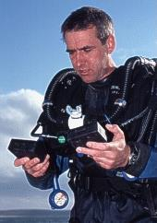
Diving with Rebreathers
Diving on rebreathers requires additional training and practice
Advantages
  Extends dive duration by the gas recycling process
  Extends no-stop dive times appropriate to gas mixed being breathed
  No or hardly any bubbles - get much closer to marine life
Disadvantages
  Rigorous monitoring
  Rigorous maintenance and preparation

Slide 17
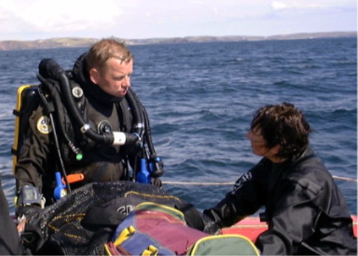
Diving with Rebreather Divers
If Sport Diver buddies a Rebreather diver
  Dive is planned to
    The most conservative decompression schedule of the gases being used
    The most conservative operating MOD determined by either of the gases used
  Must be experienced in the type of diving conditions for the dive
  Must be able to recognise underwater problems pertinent to rebreather diver
  Must be able to perform CBL and surface support on rebreather diver
Rebreather Try Dive, Practice

Slide 18
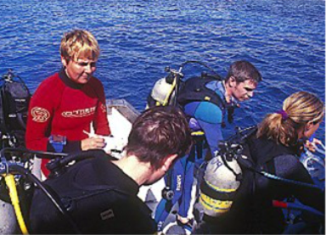
Wider Branch Role
Assistant Dive Manager
  Helps increase diver’s knowledge and understanding of dive sites and conditions
  Can help with own dive planning considerations
Being part of surface support team
  Increased diving experience
  Increased rescue skills

Slide 19
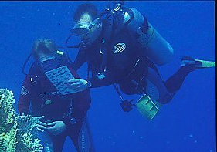
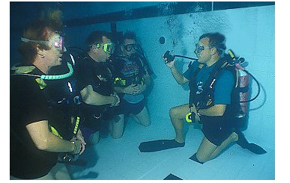
Where to go from here?
Go Diving
  Gain wide variety of experience
  Develop skills and techniques
  Increase confidence and awareness
Further training
  Dive Leader course
  Adv. Nitrox and other SDCs - BSAC Programme of Events (POE)
Interested in Instructing?
  Attend the BSAC Instructor Foundation Course

Slide 20
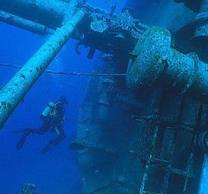
Summary
Going Diving
  A broader variety of diving and buddies
  Dive Leading
  Considering personal limitations
  Introduction to Rebreather diving
  Nitrox Diving
  Taking wider role in the Branch
    Acting as Assistant Dive Manager
    Contributing to support diving operations
  Guidance on where to go from here

