Slide 1
BSAC Sports Diver Training
Equipment & Techniques

Slide 2
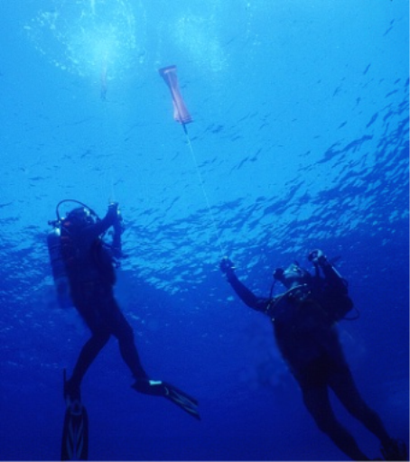
Equipment & Techniques
Aims
Shot Lines
Surface Marker Buoys
Other surface detection aids
Distance Lines
Compass
Dive Torches

Slide 3
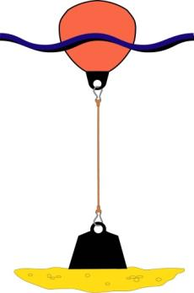
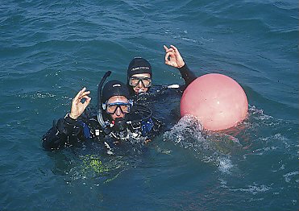
Shot Lines
What is a Shot Line?
Buoy
  Surface and underwater datum point
Line
Weight
Why use a Shot Line?
  Shortest route to/from surface
  More comfortable and secure
  Used when making deco stops
  Marked entry and exit point - safer dive management/boat cover

Slide 4
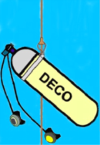
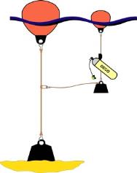
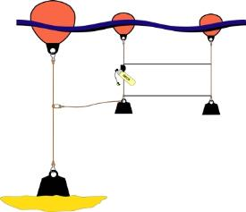
Shot Lines - Decompression
    Back-up Deco Cylinder
    Clearly labelled with gas mix% and MOD
Lazy Shot Line
  Extra line attached to main shot line
  Buoy supports spare cylinder
  Can be disconnected to drift with current - needs diver ‘logging’ system
    Decompression Trapeze
With solid bars
    All require return to shot line

Slide 5
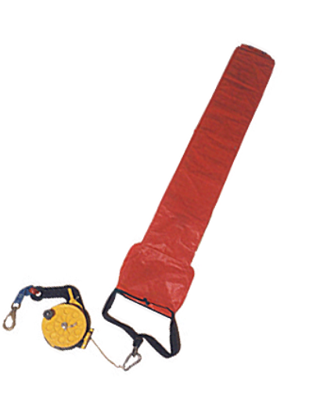
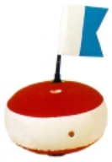
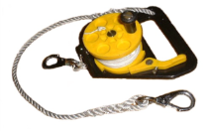
Surface Marker Buoys (SMB)
Two Types
  SMB Permanent indication of divers position
  SMB
  Delayed SMB (DSMB) Deployed from underwater by divers to indicate ascent location
Methods of deployment
Use and Precautions
  DSMB

Slide 6
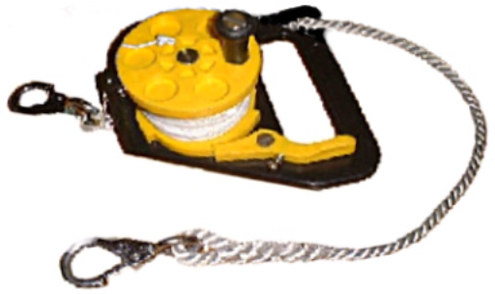
The SMB
Highly visible surface float
    Generally inflatable
    Supports 10-20 kg
    Line
    How much line? - 1.25 x dive depth - strong and thin
    Reel
    Provides safe stowage of line
    Lock off mechanism
    Quick release attachment to diver

Slide 7
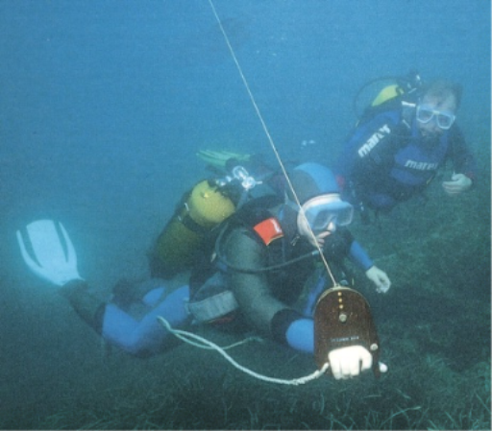
SMB - Deployment
Entry
  Carried or passed to diver after entry
Descent
  Reel out to rate of descent
  Hold reel away from body/kit
  Buddy positioning
During dive
  Keep line taut but ‘comfortable’
  Adjust for depth/lock off
Ascent
  Reel in and control buoyancy

Slide 8
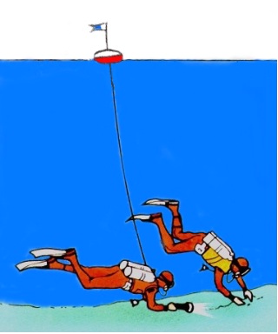
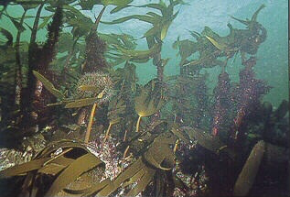
When to use a SMB
When position of divers needs to be known at all times
  Drift dives
  When divers may travel some way from entry point
  If local regulations require use
  If surface traffic anticipated
SMBs are not suitable if high risk of line snagging
  Wrecks
  Gullies below kelp, coral

Slide 9
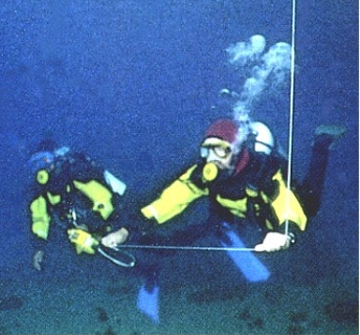
SMB - Precautions
Avoid entanglement
  Careful & controlled deployment
  Both divers’ positioning
  Aware of line at all times
Ensure reel can be quickly released if necessary
If possibility of separation - use SMB line as ‘buddy line’
  On drift dive
  Reduced visibility

Slide 10
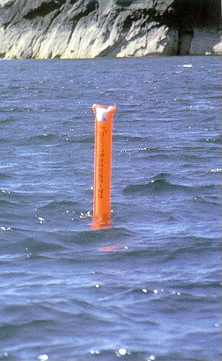
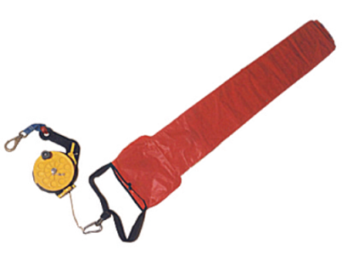
Delayed SMB (DSMB)
A marker buoy which can be inflated underwater
  Sent to the surface to mark position of divers at end of dive
  Usually sausage shaped for visibility from long range
  About 1m long with 20-25 kg buoyancy
For deployment
  A connecting line and reel

Slide 11
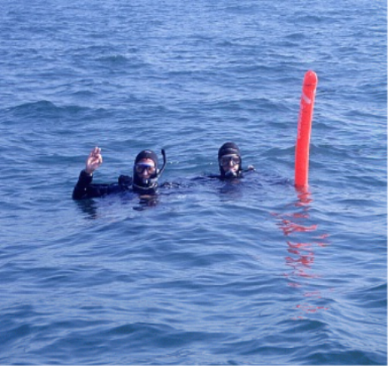
When to use a DSMB
Use when a conventional SMB is inappropriate
  High risk of SMB line snagging during dive
  Well-defined sites marked by shot lines
  Ascents from sheltered sites into a current
When not to use a DSMB
  When knowledge of the divers position at all times is essential
  In areas of significant surface traffic

Slide 12


Types of DSMB - 1
Open-ended DSMB
  Advantages
    Simple construction
    Compact
  Disadvantages
    Manual inflation
    Do not hold air well at surface
Open lower end
Over-pressure relief valve
Self-sealing DSMB
Internal non-return valve
Open lower end

Slide 13

Types of DSMB - 2
Self-inflating DSMB
Over-pressure relief valve
  Advantages
    Simplest to deploy
    Fully inflated on reaching the surface
  Disadvantages
    Least compact
    Most expensive
Inflation air cylinder
Internal non-return valve
Open lower end

Slide 14
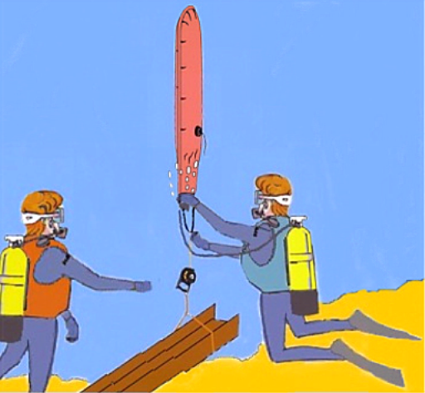
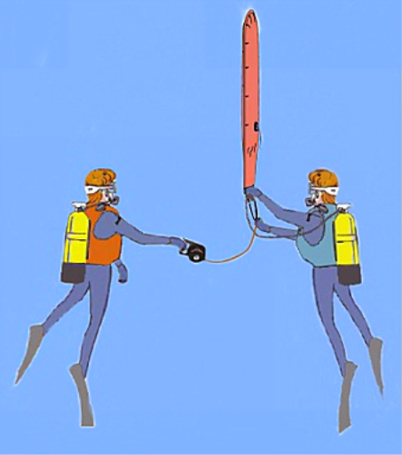
Methods of Deployment
Secured deployment
Free deployment

Slide 15
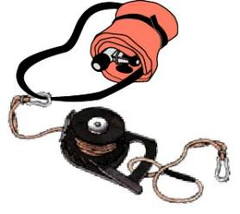
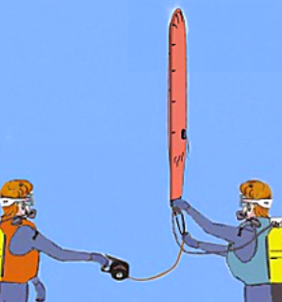
DSMB - Use & Precautions
Before diving with any DSMB
    Ensure reel is neatly coiled
    Stow neatly to avoid snagging
  Deploying the DSMB
  Ensure that it is not fastened to you !
  Self-inflating DSMB by far the easiest
  Open-ended/self-sealing DSMB
    Use AS
    Simpler if one diver holds reel while other inflates DSMB
  Initial small inflation to straighten DSMB

Slide 16
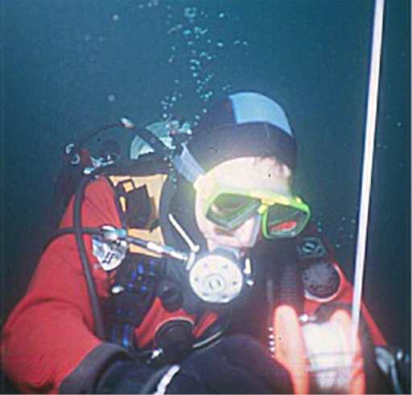
DSMB - Use & Precautions - 2
Buoyancy control
  Do not over inflate
  If mid-water, inflate below deepest stop
Keep hands clear of spinning reel
Check DSMB has reached surface
On ascent keep line under tension
In case of diver separation
  Each diver must carry a DSMB
  Each diver must be able to deploy it unassisted
  Practice - Practice - Practice !

Slide 17
DSMB – Diver to Surface Signals
DSMB used to indicate an emergency
Orange/Red deployed under normal conditions
Yellow deployment indicates a problem (Surface support to initiate emergency protocol)
Divers safely on DSMB
Emergency, Nature of problem unknown

Slide 18
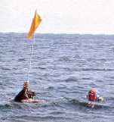
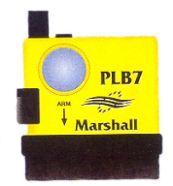
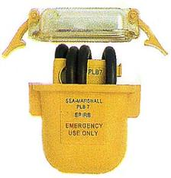
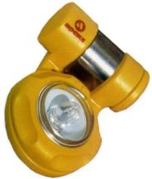
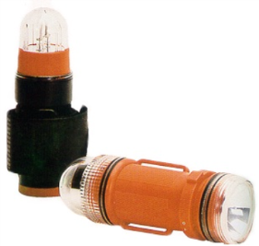
Additional Surface Aids
  Dive Flags
  EPIRBs
  Strobe lights
  Flares
  Whistles
  Mirrors

Slide 19
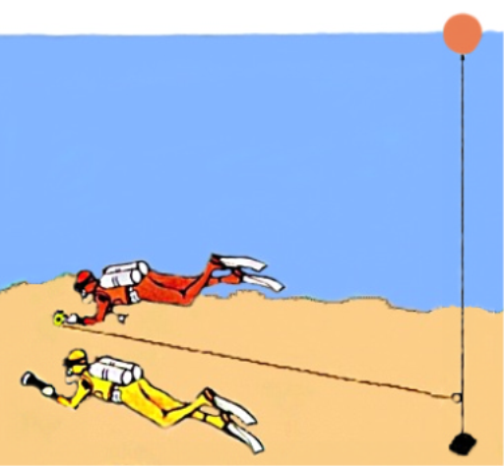
Distance Lines
What is a distance line?
  Temporary bottom line that ensures return to fixed datum point
Use when
  Guaranteed return to shot line is essential
  Visibility is poor
  The site is reasonably compact
  Can also be used as guideline for other divers

Slide 20

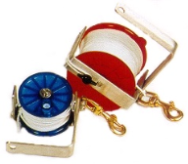
Types of Distance Line
An SMB line and reel?
  Advantage
    All divers have one
  Disadvantage
    Reel and line may be buoyant
A dedicated distance line?
  Advantage
    Weighted (sinks)
    Reduces chance of entanglement
  Disadvantage
    Heavier

Slide 21
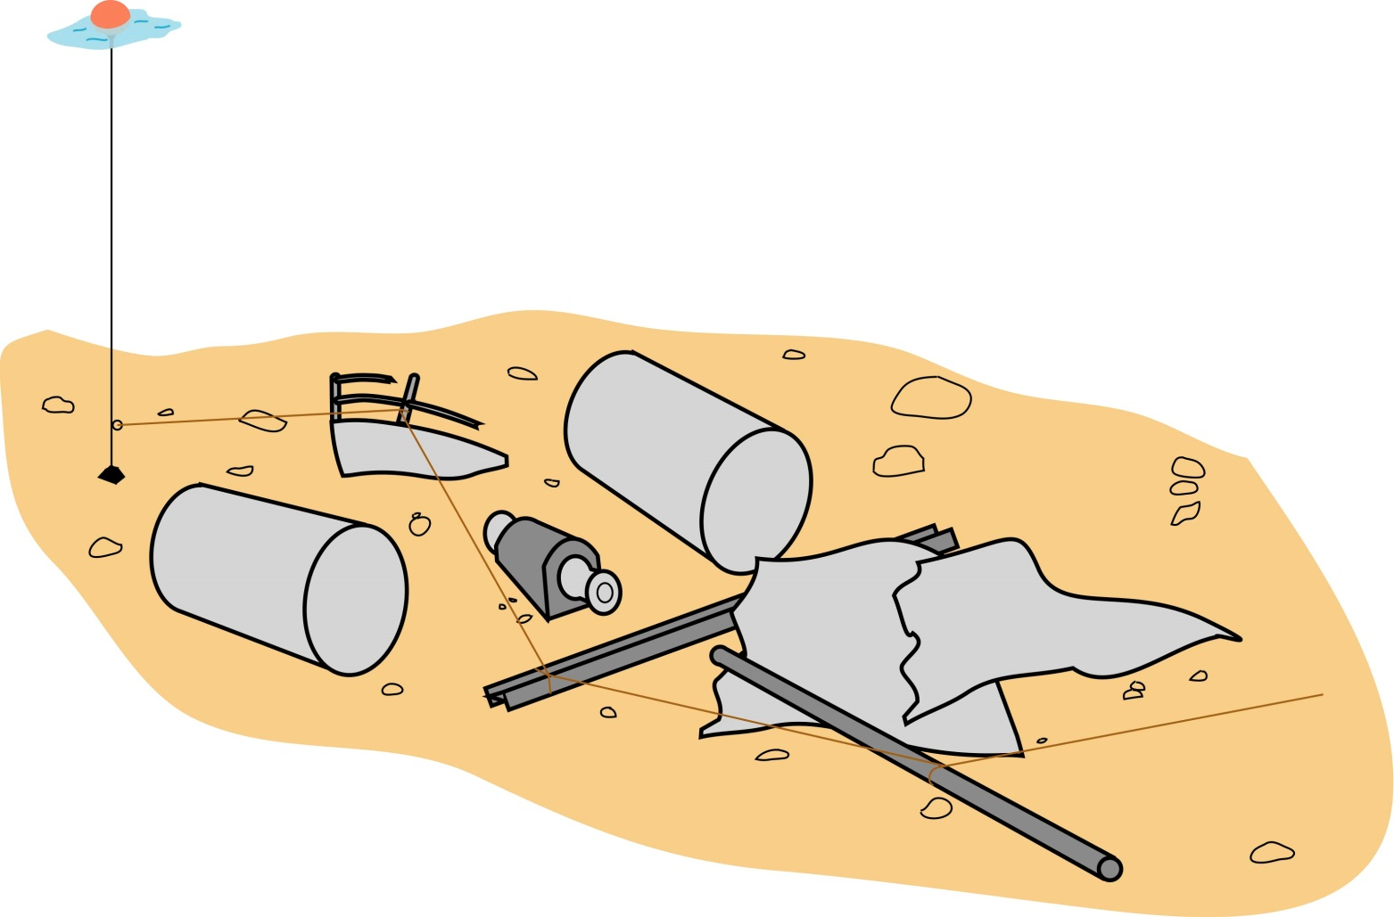
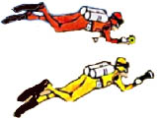
Distance Lines - Use
Non-sliding attachment to shot line
Line secured at changes of direction
SMB line? Maintain reasonable tension

Slide 22
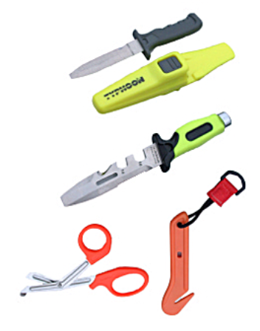
Lines and Safety
Precautions
  Sharp knife, net cutter, scissors
  Always keep line taut
  Deploy at arms length
  Avoid swimming close to line
  Avoid entanglement with other lines
  Do not use same reel for both distance and DSMB lines
  If gas/dive time is short - cut line and ascend using a delayed SMB + second reel

Slide 23
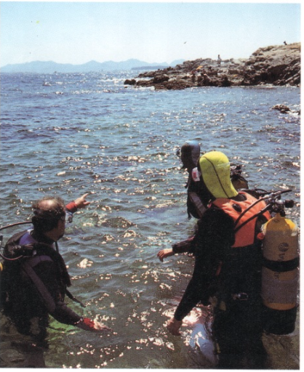
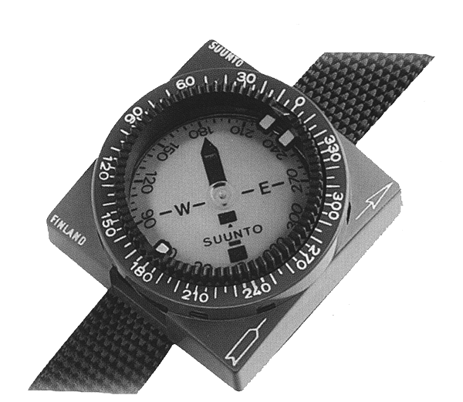
The Diving Compass
Use to:-
  Navigate to and from specific area
Magnetic north seeking needle
Cursor
Direction of travel line
Transparent oil filled unit
Lubber Line (sighting/body line)
Rotating bezel

Slide 24
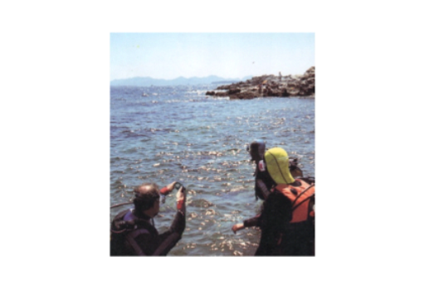
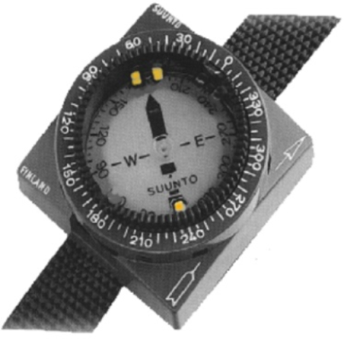
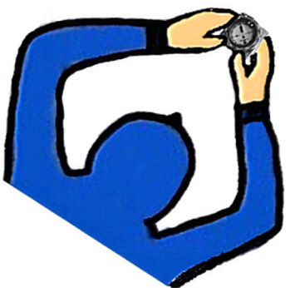
Compass Bearings
Setting the direction
  Bearing taken on surface towards site
  Compass aligned to point of interest along direction of travel arrow.
  Bearing set using rotating bezel + cursors to north seeking needle
Underwater - journey out
  Needle kept within cursor, diver aligns body with direction of travel arrow
  Time or count fin strokes
Reciprocal bearing - journey back
  Reverse/reciprocal bearing (180º difference)
  Time or fin strokes back to start point

Slide 25


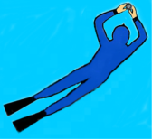
Compass - Use & Precautions
Use
  Compass held level, direction of travel arrow to centre line of diver’s body
  Current - keep bearing but angle finning
Sources of error
  Magnetic influences
    Wrecks
    Any other ferrous metal
  Disbelief!
Precaution
  Fixation!
Bearing to site

Slide 26
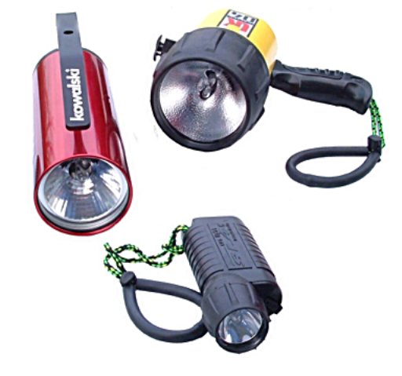
Diving Torches
Illuminates dive area
  Colours, points of interest
Essential for night dives
Many types of torch
  Pressure rated
  Robust
  Battery or rechargeable
Torch care
  Bulbs, O’ ring seals !
  Wash after every dive
  Torches & safety
  Lights the diver’s position

Slide 27
Summary
Equipment & Techniques
  Shot Lines
  SMBs and DSMBs
  Other surface detection aids
  Distance Lines
  Compass
  Dive Torches
Ensure all equipment
  Kept in good working order
  Washed/checked after each dive
PRACTICE - PRACTICE - PRACTICE

