Slide 1
BSAC Sports Diver Training
Diver Rescue

Slide 2
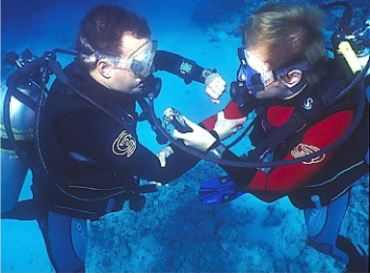
Diver Rescue
Aims
Anticipation, planning and awareness by divers
  Prevents problems before they happen
  Prepares them to give assistance if problems arise
  Prepares them to effect a rescue if necessary
Rescue Skills
  Types of rescue
  Practical session

Slide 3
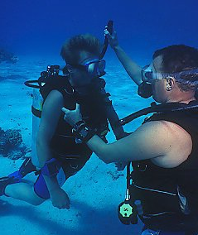
Effective Rescues
Rely upon
  Training and experience
  Well organised diving and surface support
  Practised rescue skills
    CBL, AS
    Basic Life Support (BLS) -
    Rescue Breathing (RB)
    Chest Compressions (CC)
  The Buddy system
    Anticipation and planning
    Buddy check - every dive
    Monitoring throughout dive

Slide 4
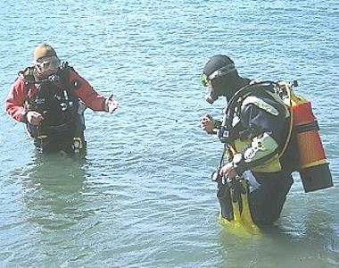
Pre-dive Buddy awareness
Typical indications
  Nervous or reluctant
  Excuses or repeated questions
  Stress indicators
  Slow kit up or constant fiddling
Concerns need to be resolved
  Adapt the dive plan
  More suitable dive site
  Peer pressure

Slide 5
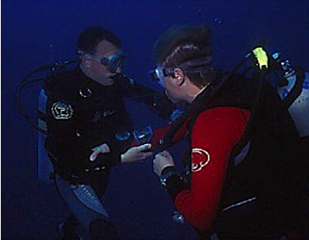
Buddy awareness on a dive
Buddy reactions
  Stopping for no reason
  Preoccupation with kit
  Slow response to signals
  Rapid breathing
  Wide staring eyes
Resolve quickly
  Stop or move to buddy
  OK? Problem?
  Not OK, gentle but firm contact
  Abort dive

Slide 6
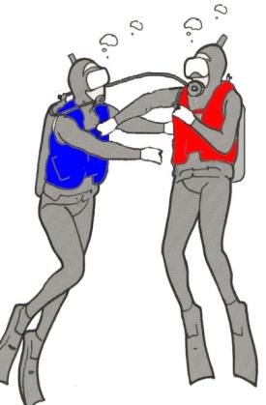
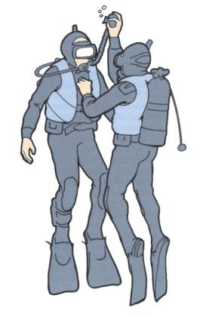
Rescue - to the surface
Diver out of gas
  AS ascent
Incapable/unconscious diver
  CBL
Rescue ascents - Urgent
  Ascend directly to surface
  May mean ignoring decompression stops
  Divers safer at surface
  DCI can be treated
  Actions to take in case of oxygen convulsions
Controlled
Buoyant Lift
AS ascent

Slide 7
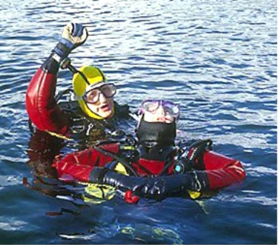
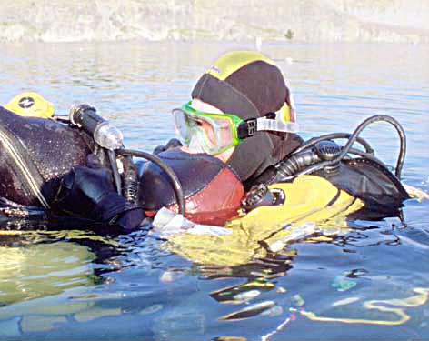
Surface Tows to Shore
Summon help
  Ensure casualty buoyant at surface
    Fully inflate BC - face clear of water
      Consider removing weights
    Summon assistance
Conscious casualty
  Reassure
Unconscious casualty
  Remove mask, mouthpiece and extend airway
Non Breathing casualty
  Remove mask, mouthpiece and give RB for 1 minute i.e. 10RBs

Slide 8
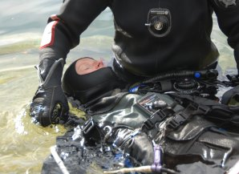
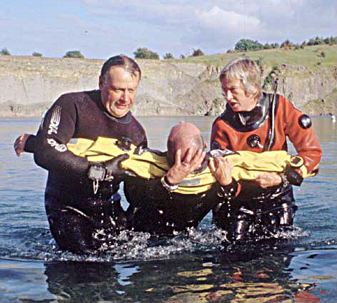
Landing casualty - Shore
Standing depth
  De-kit and land as quickly as possible WITHOUT further rescue breathing
  Lift from water
  Contact emergency services
  Continue BLS

Slide 9
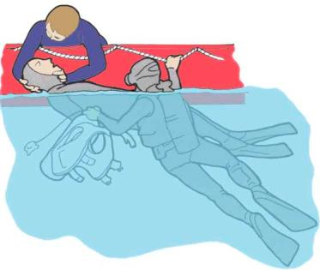
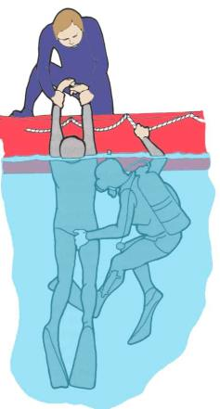
Landing Casualty - Boat
Assistance available
  De-Kit and remove from water as quickly as possible WITHOUT further RB
  Contact emergency services
  Continue BLS

Slide 10
In Water Life Support Sequence
Make Buoyant
Extend Airway
RB for 1 minute
Tow to shore
or RB while waiting for boat
De-Kit and Land/recover

Slide 11
Priorities of BLS – Dr ABC
Danger - to casualty and rescuer
Response
  A - Alert
  V - Responds to Voice
  P - Responds to Pain
  U - Unresponsive
Airway - clear of obstructions
Breathing - check for normal breathing (10 secs.)
Circulation – Cardiac Compressions

Slide 12
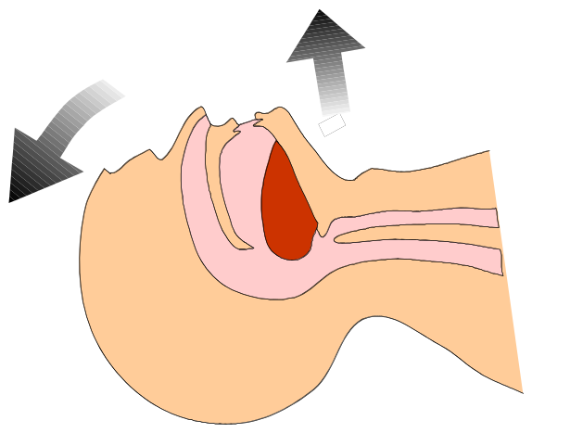
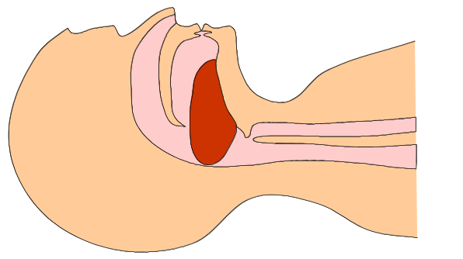
Airway
Clear the airway
  Foreign objects
  Tongue
  Neck extension
Airway blocked by tongue
Head tilt/chin lift clears airway
  Check for breathing

Slide 13
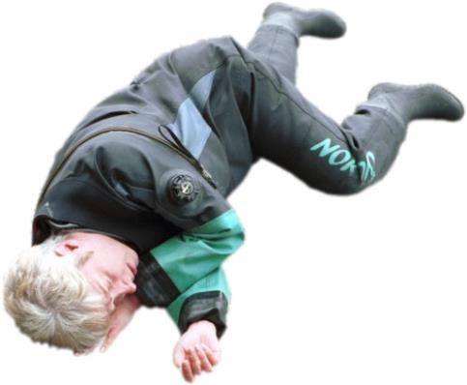
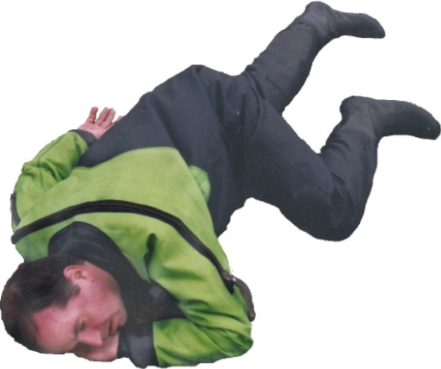
Recovery position
If casualty breathing place in recovery position
The ‘how’ position
More stable position

Slide 14
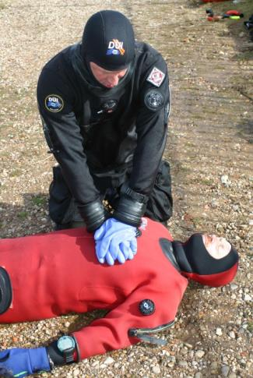
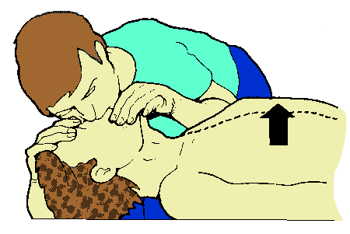
Unresponsive Casualty
If casualty not responding and not breathing
  Administer CC and RB

Slide 15
Basic Life Support - Decision process & Sequence
No
Unresponsive?
Leave Casualty and get help
Yes
Shout for help, open up airway
No
Call help, leave if necessary 30CC/2RB (30:2)
Breathing Normally?
Yes
Stop to recheck only if breathing resumes, else continue until:
Qualified help arrives
Normal breathing
You are exhausted
Recovery Position

Slide 16

Basic Life Support
  Sequence of
  30 compressions: 2 breaths by one rescuer
  Monitor effectiveness
  Stop if normal breathing resumes/medical assistance arrives
  Two rescuers: change role every 2 minutes

Slide 17

Basic Life Support - CC
  Place heel of hand in centre of chest
  Place heel of other hand on top of first hand
  Straight arms – press down on sternum 5 – 6 cm
  Repeat at 100-120 times/min

Slide 18
Basic Life Support - RB
Expired air can sustain life
Monitor effectiveness
Don’t over
ventilate
  Sight
  Feel
  Sound
  Appearance
Continue until qualified help comes, the casualty is breathing normally or you are exhausted
Regurgitation
  Not always normal vomiting
  Monitor exhalation sounds

Slide 19
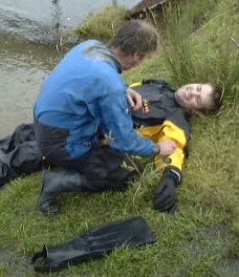
Casualty Care
Tender loving care (TLC)
  Reassure at all times
  Protect from elements
  Casualty records
  Friends or family contact
Post incident support & considerations
  Support required
  BSAC Incident Report
  Successful rescues
Feedback important
  Part of maintaining safety record of our sport

Slide 20
Summary
Preventing problems
  Anticipation and planning
  Monitoring buddy before/during dive
Resolving problems
  Assist to resolve
Effecting a rescue
  To the surface
  Surface to shore or boat
Basic Life Support
  CC and RB

