Slide 1
BSAC Sports Diver Training
Sport Diving

Slide 2
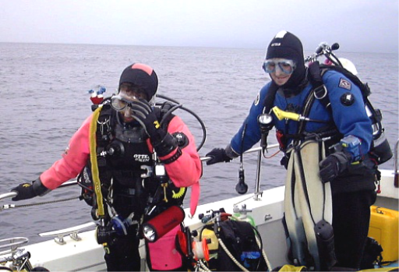
Why become a Sports Diver?
Aim of the course
Extend Experience and Skills
  Diving a variety of sites in varying conditions
  Considering additional equipment & gas mixes
  Extending rescue skills
Self Risk Assessment
  Knowing personal limits

Slide 3
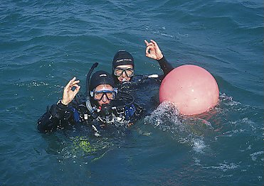
Sports Diver Course
  Course Content
  6 theory lessons
  1 sheltered water lesson
  5 open water lessons
  1 dry practical lesson
  Experience 5 different diving conditions
  Commitment
  Self study
  Student Notes
  Safety and Rescue Manual

Slide 4
Sports Divers
  Can dive with an Ocean diver
    In conditions already encountered by the Ocean Diver during their training, and under supervision of Dive Manager
  Can dive with another Sports Diver
    In conditions already encountered during their training or previous experience
  Can dive with a Dive Leader or above
    To expand experience beyond that previously encountered, under supervision of Nationally Qualified Instructor (NQI)
  Can dive to:
    Depth initially limited to 20m but can be progressively extended under supervision of NQI
  Plan and conduct dives requiring mandatory decompression stops

Slide 5
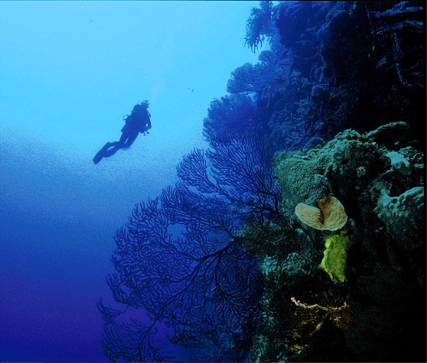
Variety in Diving
Dive sites
  Reefs and walls
  Gentle drift diving
  Wrecks
Underwater conditions
  Depth
  Currents
  Restricted visibility
  Temperature
Surface conditions
  Entry and exit
  Surface cover/support

Slide 6
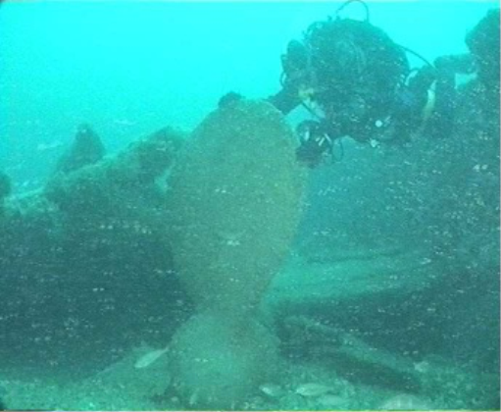
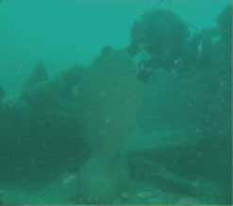
Underwater Conditions
  The same site - conditions vary
  Anticipation as part of planning

Slide 7



Depth - Tides & the Moon
Moon’s gravity pulls ocean towards it
    Bulge of high water
    Bulge on opposite side of Earth
  Sun’s gravity also has an effect
  ‘Neap’ (small) tides
  ‘Spring’ (large) tides
  Tide cycle approx.. 12 hours
  Moon (Lunar) month = 28 days

Slide 8
Depth - Tides
HW
Tidal range
  Low water (LW)
  High water (HW)
Depths on dive site may vary
Tidal Range
LW
Tidal Range
= 4m
HW = 25m
LW = 21m

Slide 9
Currents & Ground Swell
Tidal currents
  Tides: fall (ebb), rise (flood)
    Water moves to and fro
    Period of least water movement - slack water
Static sites
Drift diving
Ground swell
  Wind = wave action
    May be felt on seabed
Slack Water

Slide 10
Underwater Visibility
  Wind generated wave action
  Plankton blooms
  Currents
Local seabed conditions
  Easily disturbed by divers!
Depth
  Reduction in light penetration

Slide 11
Water Temperature & Salinity
Climate
  Seasonal variations
Depth
  Colder the deeper you go
Currents
  Carry warm or cold water
Thermoclines
  Changes in temperature
Salinity
  Salt concentration can affect buoyancy

Slide 12
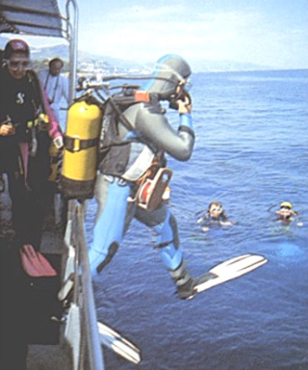

Surface Conditions
Weather may affect:
  Travelling to the site
  Entry and exit
Surface visibility
  Mist or fog
  Wave height
  Glare
Other water users
  Large shipping
  Other dive boats
  Yachts, motorboats, etc.

Slide 13
Local Knowledge of Sites
Dive Manager/Lead Instructor
  Brief includes
    Site description
    Anticipated conditions
    May give maximum dive time dependent on slack water
Dive School or Centre
  List of known dive sites
Dive books, guides and magazines
  Description of site
0
SW
5
10
Cliff face - lots of marine life
Overhangs and small caves
Caution: fishing line
Large boulders and pieces of wooden wreck
15
20
25
30
30m

Slide 14

Risk Assessment - Potential Problems
  Conditions
    Separation
    Cold
    Working too hard
  Depth
    Increases risk of DCI
    Nitrogen narcosis
    Incidents - further to surface
  Breathing Gas supply
    Loss - faulty equipment
    Depletion - increased effort
  Equipment
    Faulty
    New
  Conditions
  Depth
  Breathing Gas
  Equipment

Slide 15
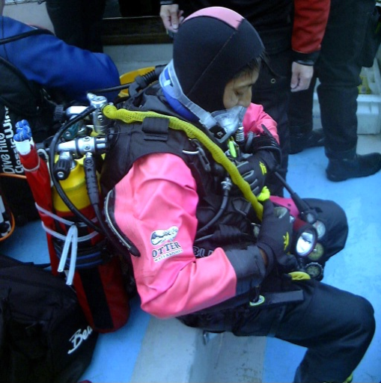
Minimising Risk to Self and Buddy
Precautions
  Conditions
    Suitable for level of experience
  Depth
    Dive profile - maximum depth
    Decompression stops
    Check for narcosis
    Practised rescue skills
  Breathing Gas supply
    Sufficient for dive & decompression
    Adequate back up supply
  Equipment
    Serviced
    Buddy check
  Conditions/Equipment/Self DO NOT DIVE

Slide 16
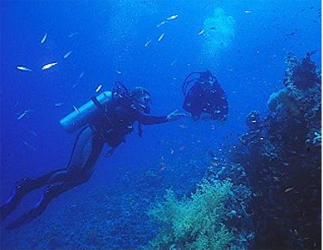
Know your personal limits
Stay within your personal limitations
  Do the type of diving you want to do
  Avoid pressure to extend experience or depth too quickly
  Challenge of diving tempered by being prepared for the challenge
  Don’t rush - gradually consolidate experience

Slide 17
Summary
  Outline of Sports Diver Course
  Factors affecting conditions on a dive site
  Anticipating conditions as important part of dive planning
  Consideration of other factors that could impact on dive safety
  Knowing personal limits

