Slide 1
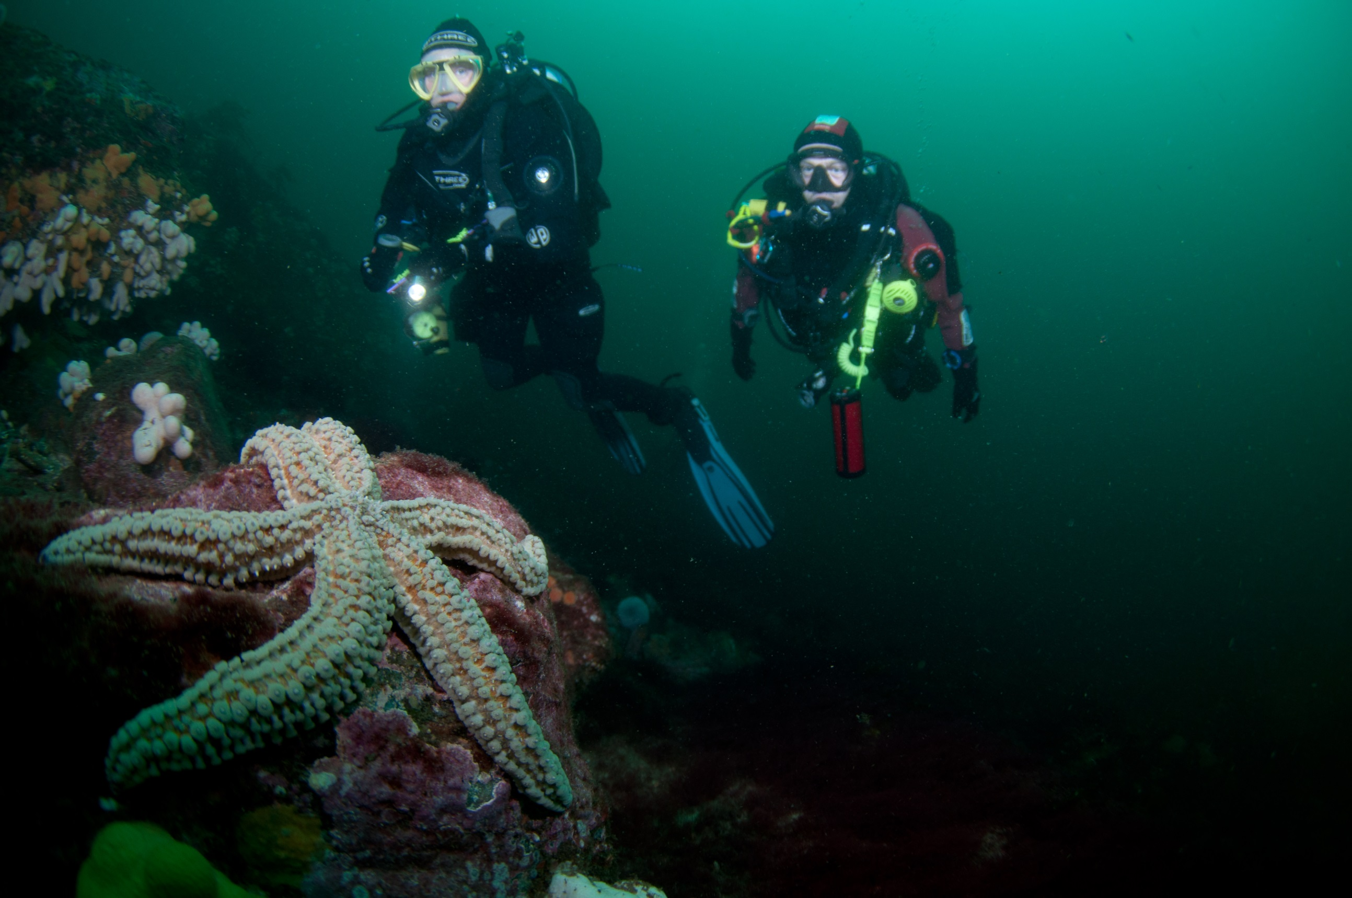

Enjoying your diving
Module OT6
Ocean Diver

Slide 2
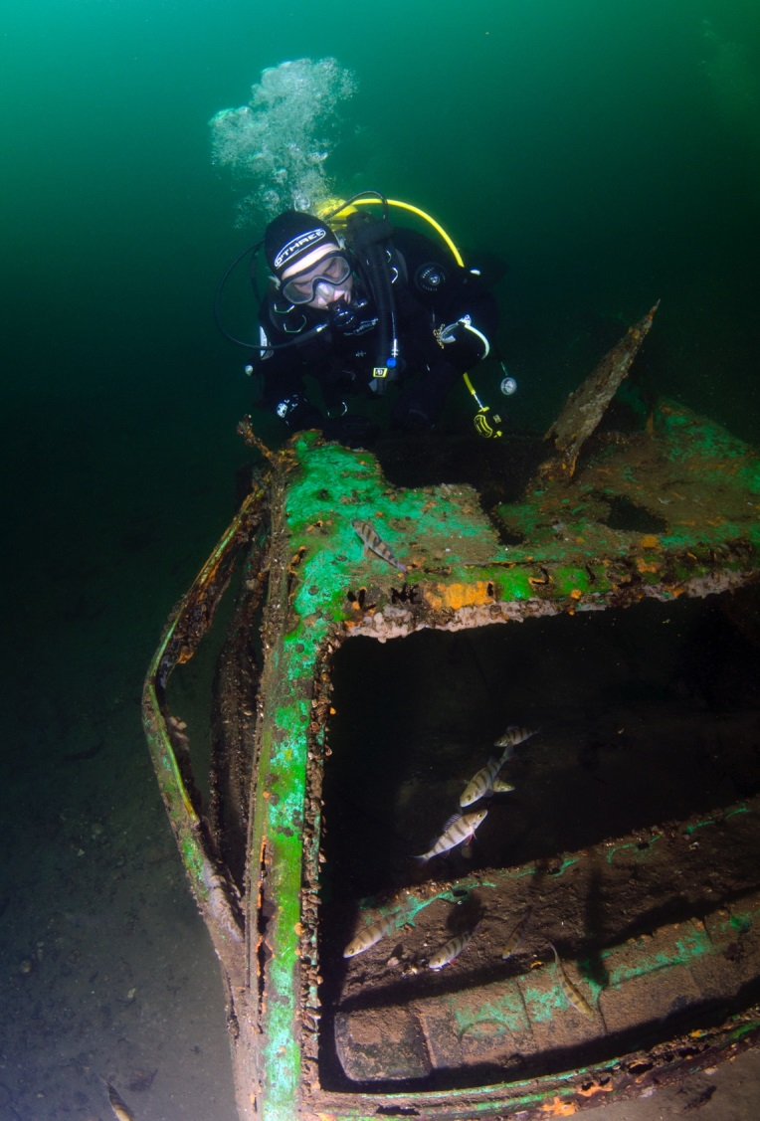
Module content
Different dive sites
  Inland and sea diving
  Local diving conditions
Different dive platforms
  Shore and boat diving
Different types of diving
  Reef, wreck and night diving
Responsibilities
  Marine conservation
  Wreck protection
Know how to plan
  Holiday diving
  Skill progression

Slide 3
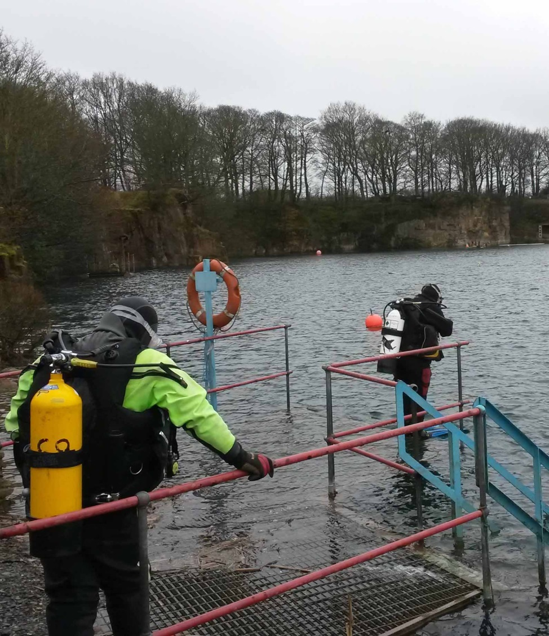
Diving at inland sites
Good environment for training and building experience
Quarries, lakes and lochs
  Protected from worst of the weather
  All year round diving
Site facilities
  Vary
  Generally accessible from shore
  Climate and temperature
  Temperate - thermal surface protection
  Tropical - sun protection

Slide 4
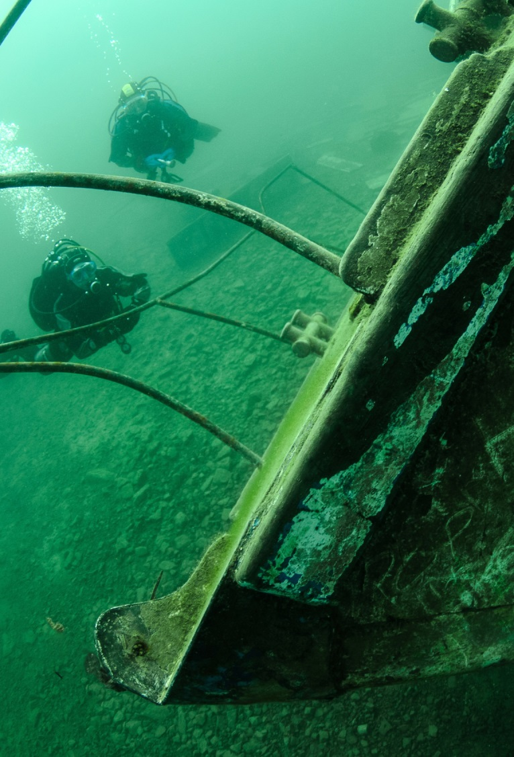
Diving at inland sites (2)
Surface conditions
  Generally good
Underwater conditions
  Vary depending on site
  Currents can be present
  Water temperature colder than sea
Inland sites not 'easy option’
  Can be dark
  Can be deep

Slide 5

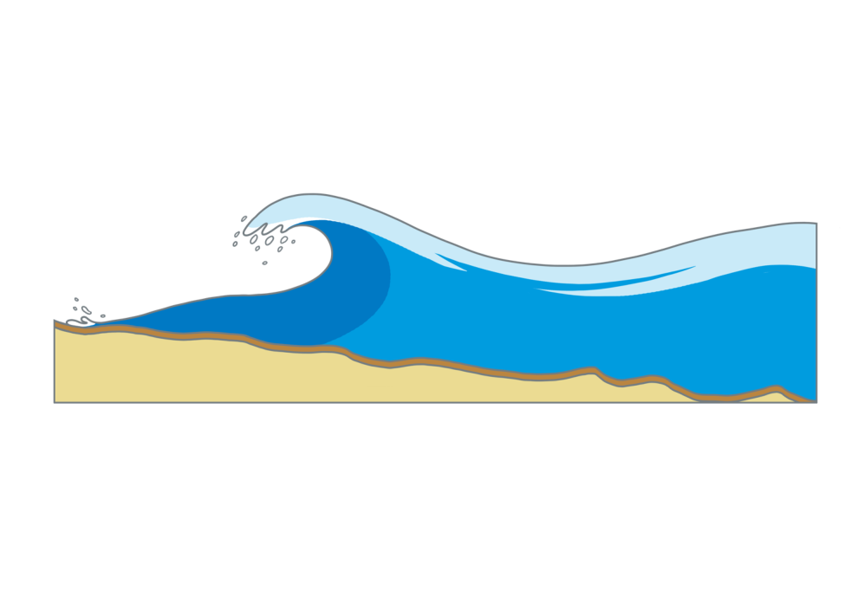

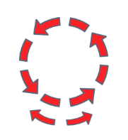

Diving in the sea
Also a good environment for training and building experience
Site facilities
  Vary
  Boat or shore access
Surface conditions
  Waves formed by wind
  Wave heights increase in shallow water
  safe entry and exit?
  Seasickness

Slide 6
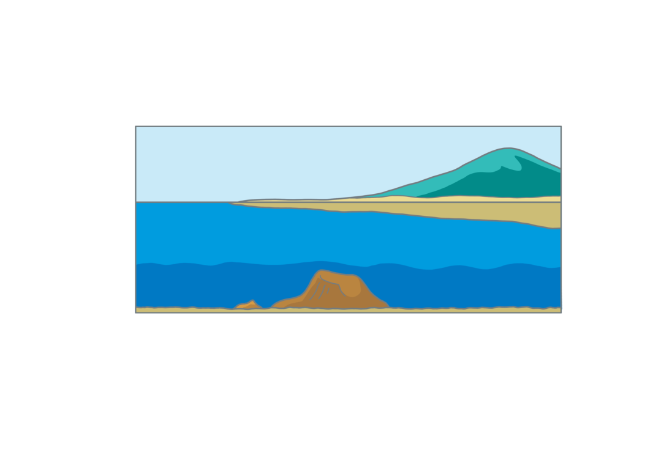
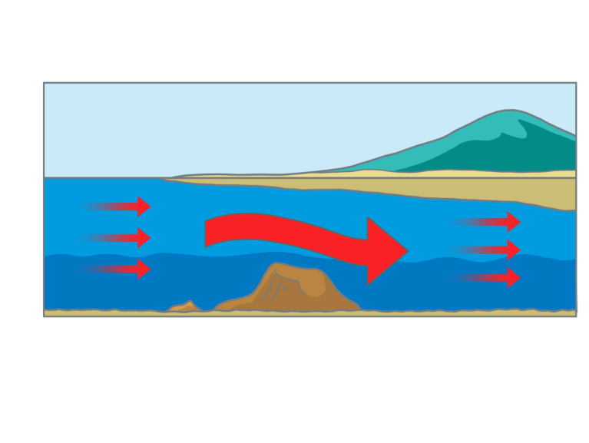
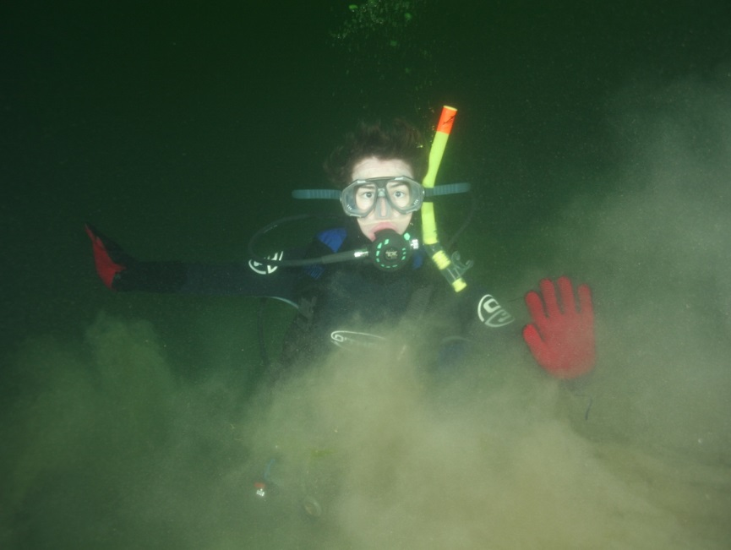
Diving in the sea (2)
Underwater conditions
  Tidal movement causes currents
  Land and underwater features affect currents
  Ground swell
Underwater visibility
  Variable
  Recent weather
  Seasonal variations
  Other divers

Slide 7
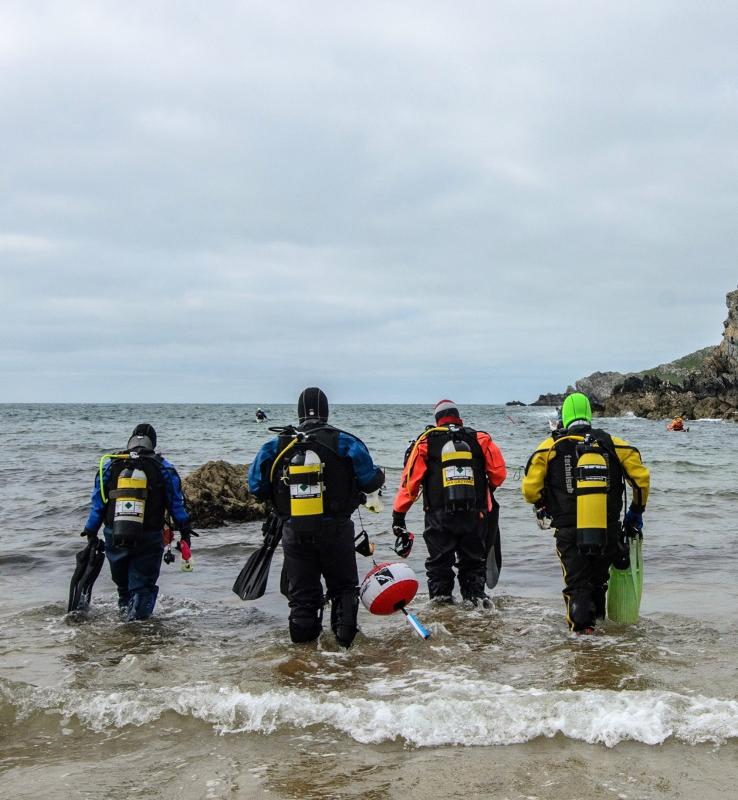
Shore diving
Considerations
  Safe entry/exit
  Facilities
Sea conditions
  Depth
  Waves
  Currents

Slide 8
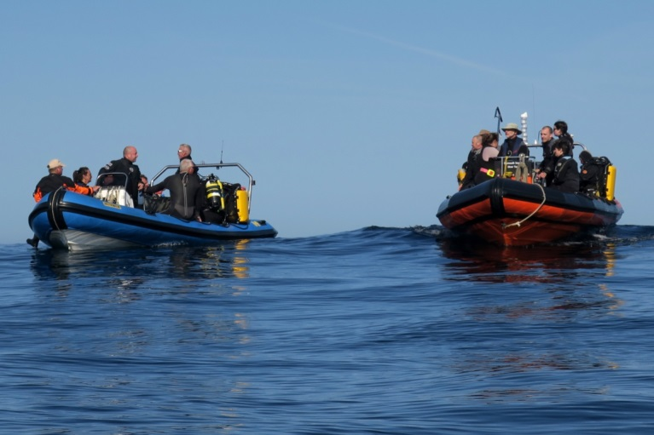
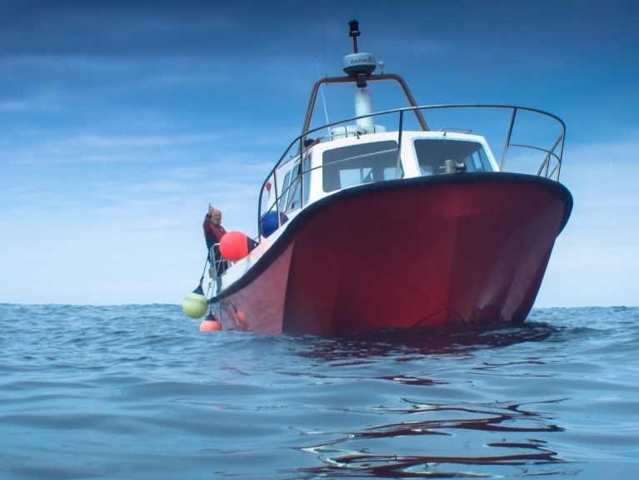
Small boat diving
Rigid-hull inflatable boats (RIBs)
  Highly manoeuvrable
  Almost unsinkable
  Entry/exit over the tubes
  Open to the elements
  Limited kit storage space
Small hard boats
  Very manoeuvrable
  Good diving platform
  Ladders and lifts
  Some protection from elements
  Toilets or ‘heads’
  Refreshments

Slide 9
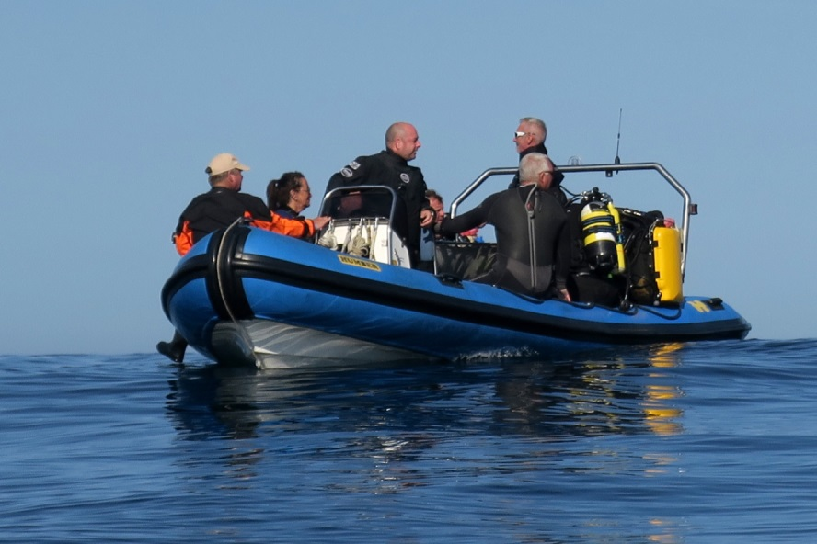
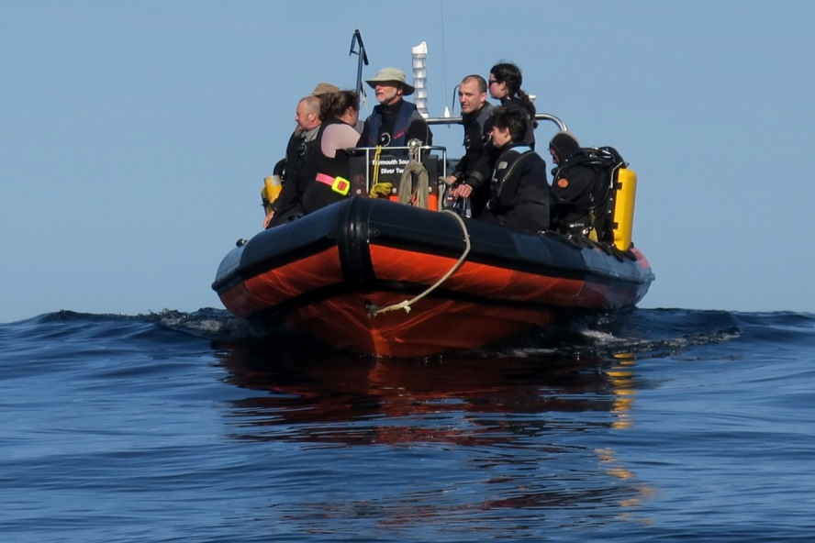
Diving from a RIB
Advantages
  RIBs can be towed to different launch sites
  Can reach inaccessible coastal sites
  Can reach offshore sites
  Provide safety cover for divers
Disadvantages
  Return to base after each dive
  Open to the elements – need protective surface clothing
  Limited kit stowage areas
  Limited kitting-up space
  Food/drink supplied by divers

Slide 10
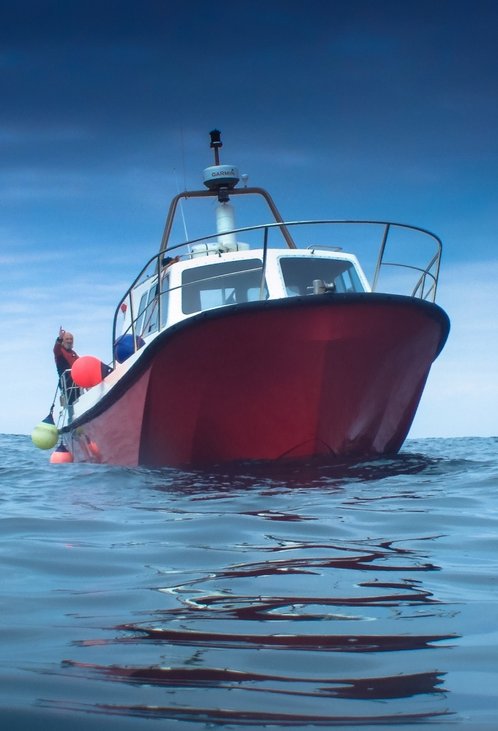
Diving from a small hard boat
Advantages
  Can reach inaccessible coastal and offshore sites
  Skipper’s local knowledge
  Good deck and kitting-up space
  Some protection from the elements
  No need to return to base between dives
  Provide safety cover for divers
Disadvantages
  Restricted kit stowage areas
  Need more cylinders

Slide 11
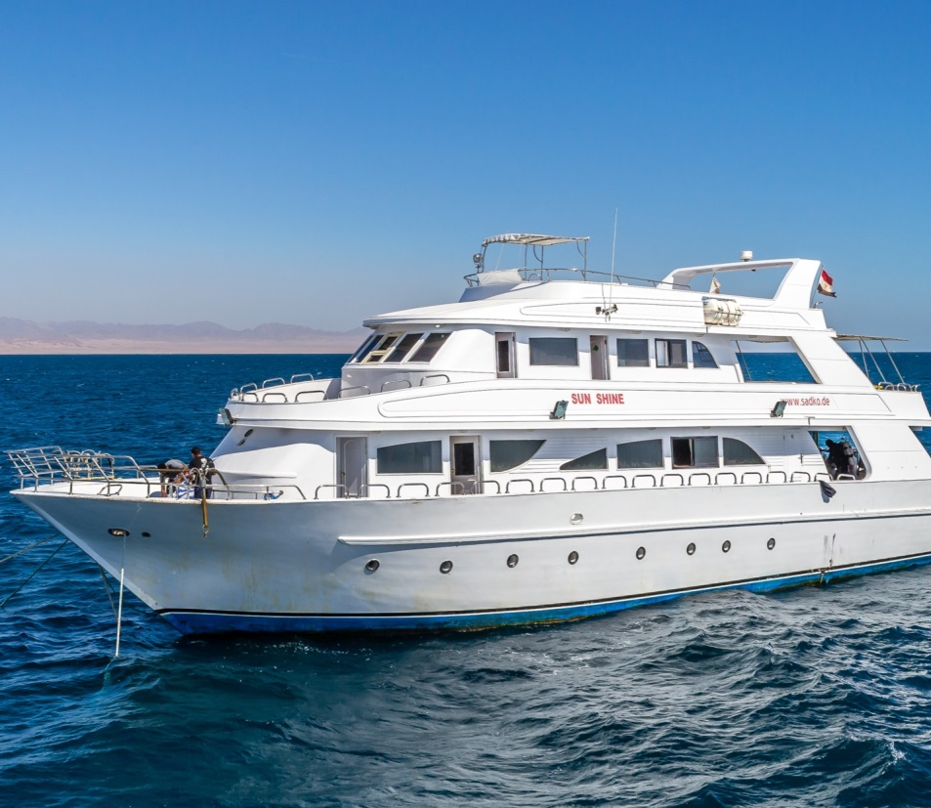
Diving from a live-aboard boat
Advantages
  Floating, mobile ‘hotels’
    cabins
    saloons - TV, Video
    cooked food
  Travel further afield - remote sites
  Skipper’s local knowledge
  Good deck and kitting-up space
  All-weather protection
  Compressor onboard, cylinders
  Relaxing way to dive
  Provide safety cover for divers

Slide 12
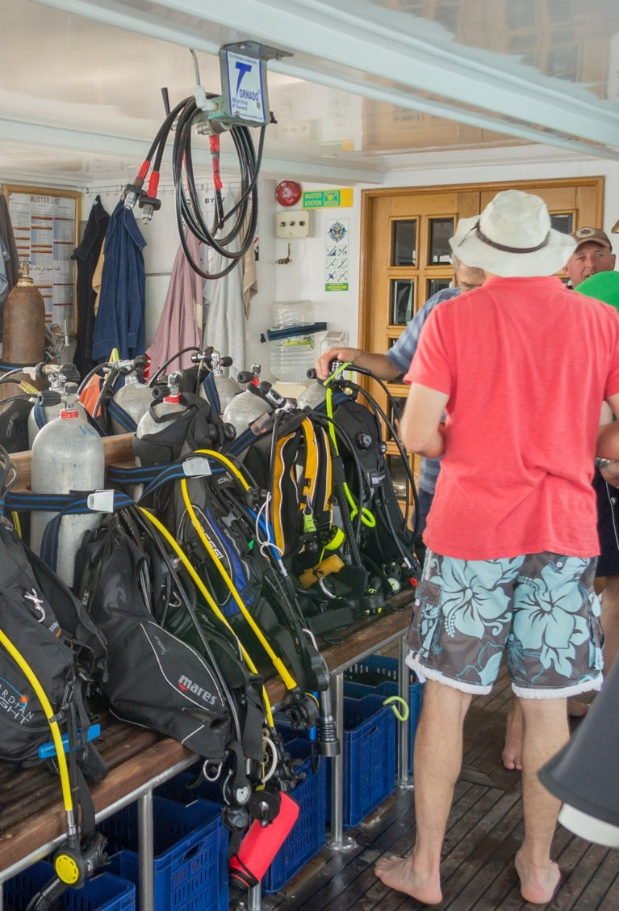
Diving from a live-aboard boat (2)
Disadvantages
  Cost - charter includes full board
  Returning to shore may not be an option
  Diver needs to be self sufficient with their kit
  Need to get along with all divers on board

Slide 13
Quiz 1
What are the advantages of diving from a RIB?
  RIBs can be towed to different launch sites
  Can reach inaccessible coastal sites
  Can reach offshore sites
  Provide safety cover for divers

Slide 14
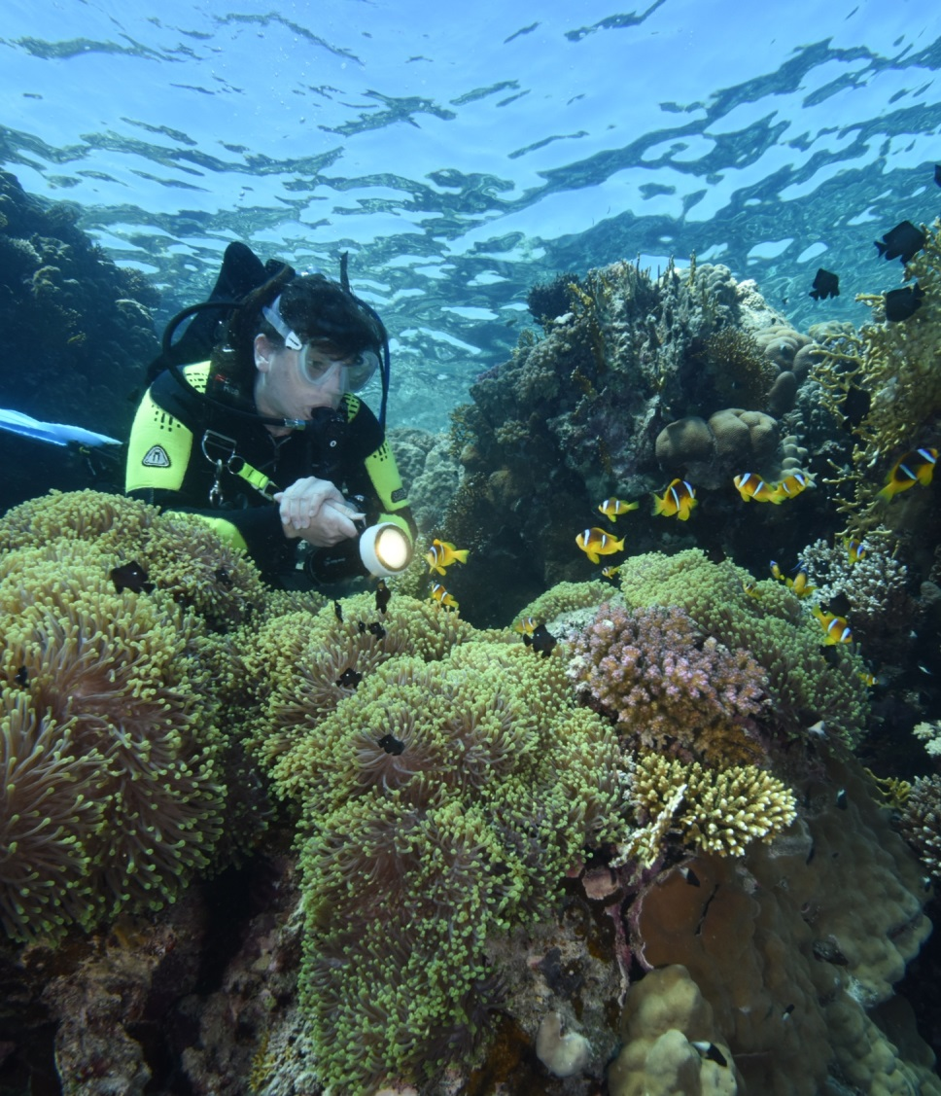
Reef diving
Attractions
  Marine life
  Underwater scenery
  Photographic opportunities
Potential risks
  Over extending depth or time
  Hazardous marine life
  Wave action and currents
Precautions
  Dive monitoring
  Look don’t touch
  Plan the dive, dive the plan

Slide 15
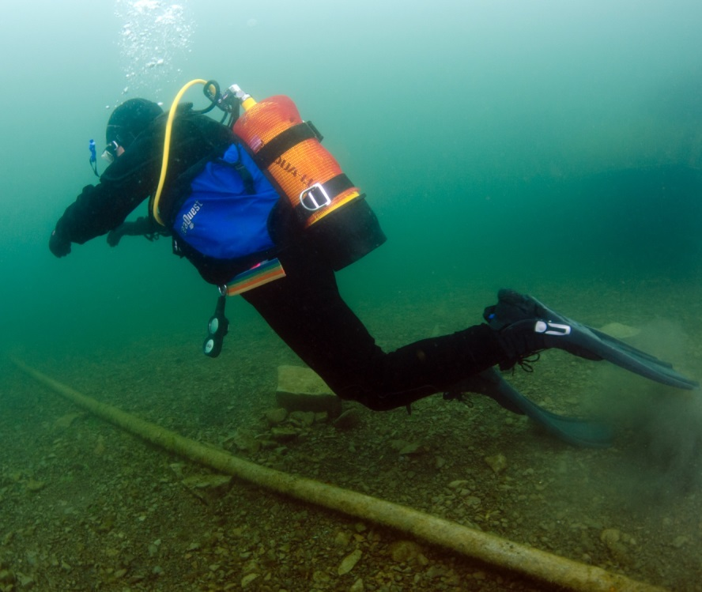
Marine conservation
Protect the underwater environment
  Excellent buoyancy control
  Good finning technique
  Look but don’t touch
  Take only memories and photographs
  Participate
    BSAC sea life tracker app

Slide 16
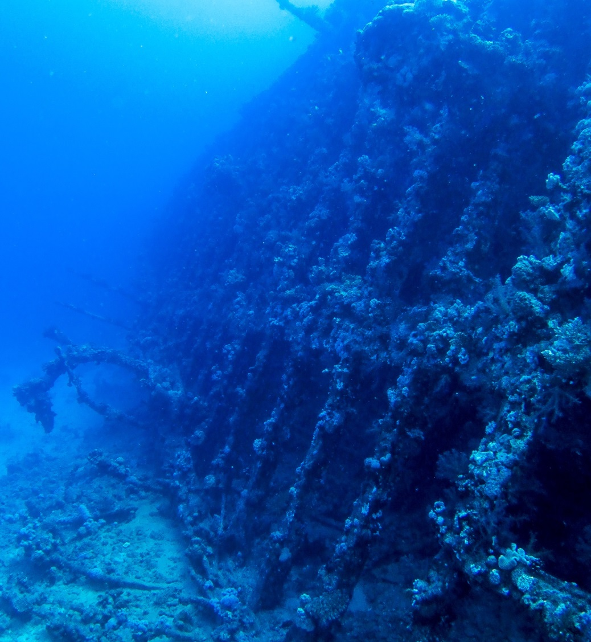
Wreck diving
Attractions
  Artificial reefs - marine life
  Underwater heritage
  Photographic opportunities
Potential risks
  Fishing nets/lines
  Silt
  Overhead environment
    Unintentional wreck penetration
  Decay
    Loose sections
    Sharp edges
    Rust – visibility
  Munitions
Precautions
  Knife line cutter
  Good buoyancy and finning techniques

Slide 17
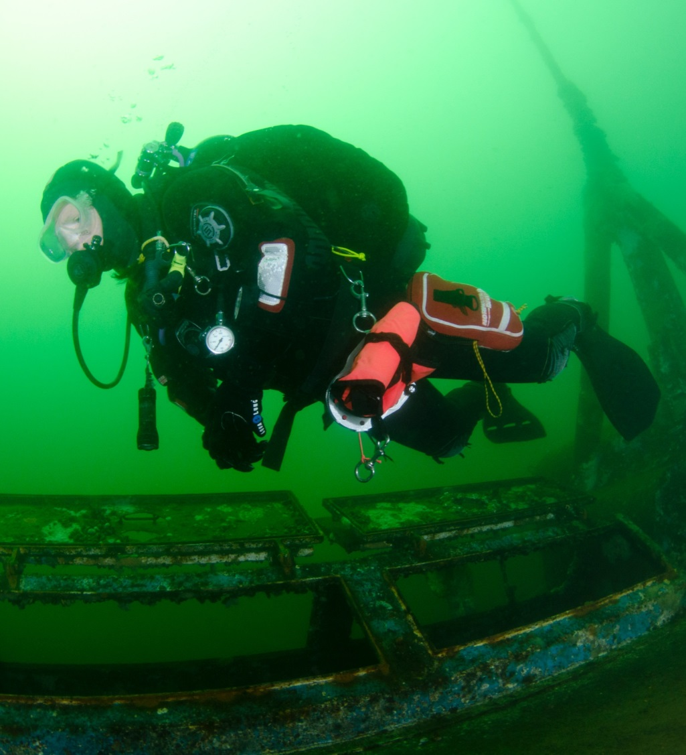
BSAC wreck-diving policy
Respect our Wrecks
  Respect our underwater heritage today, everyone can enjoy it tomorrow
  Look but don’t touch
    War graves
    History
    The law

Slide 18
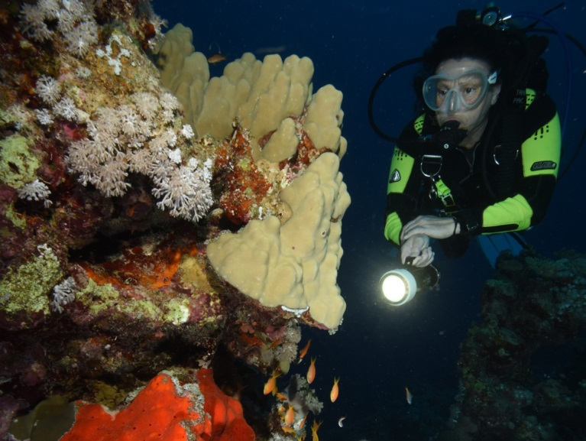
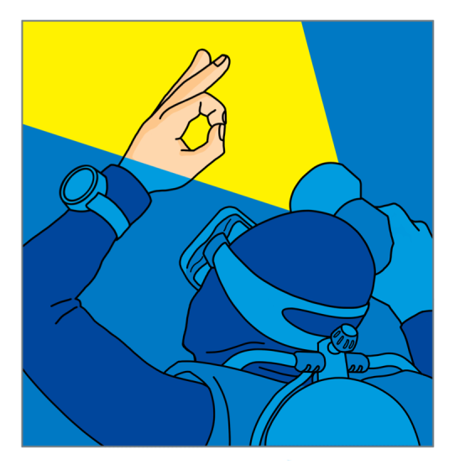
Night diving
Attractions
  Nocturnal marine life
  Torch beam focuses attention
  Enhanced colours
Potential risks
  Separation
  Disorientation
Precautions
  Torch and backup torch
  Torch signals
  Avoid shining in eyes
  Surface lights on shot and kit

Slide 19
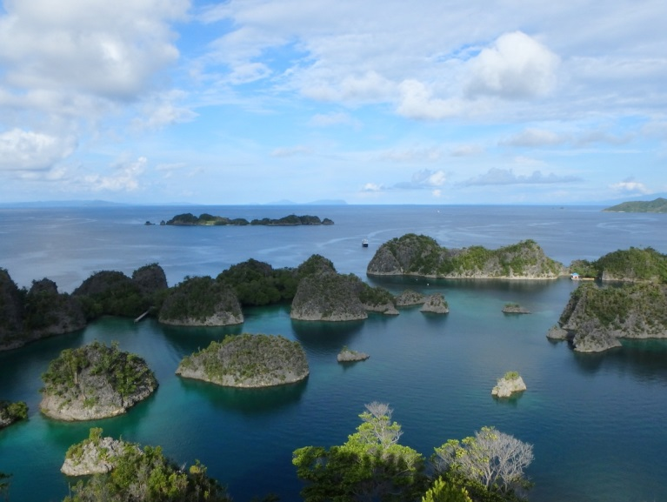
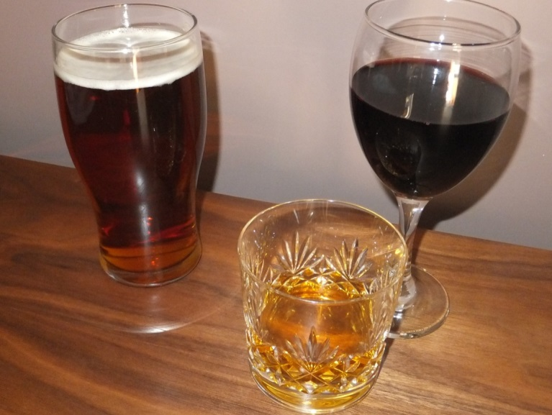
Holiday diving
General points
  Check out dives
  Holiday insurance: limits
  Be aware of local regulations
Diving with other dive organisations
  Different agencies use different signals
  Group diving
  Q-card and log book
Relaxing
  Avoid recreational drugs and alcohol
  Dehydration
Equipment
  Hire or take

Slide 20
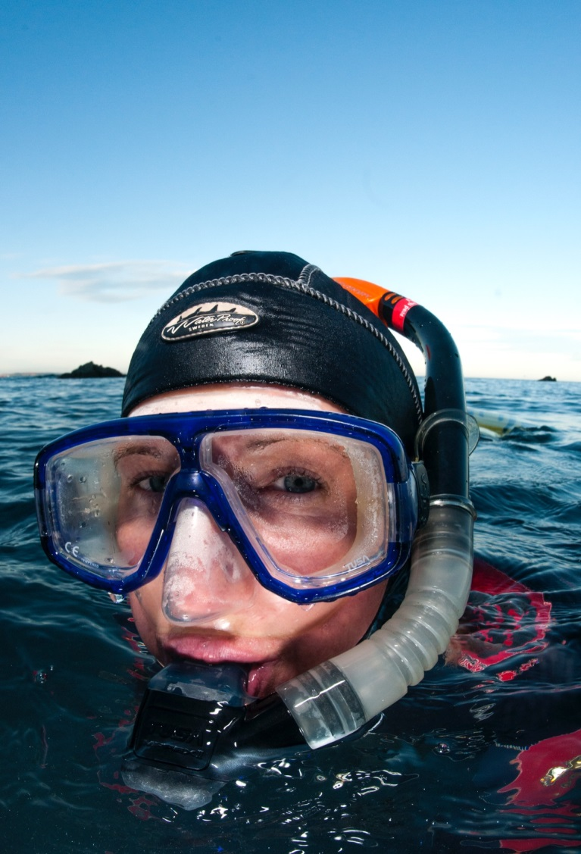
Holiday snorkelling
Same considerations as for
  Shore diving
  Small-boat diving
  Live-aboard diving
  Reef diving
Snorkel buddy diving
  One up, one down
Tropical snorkelling
  Sunburn protection even when in water

Slide 21
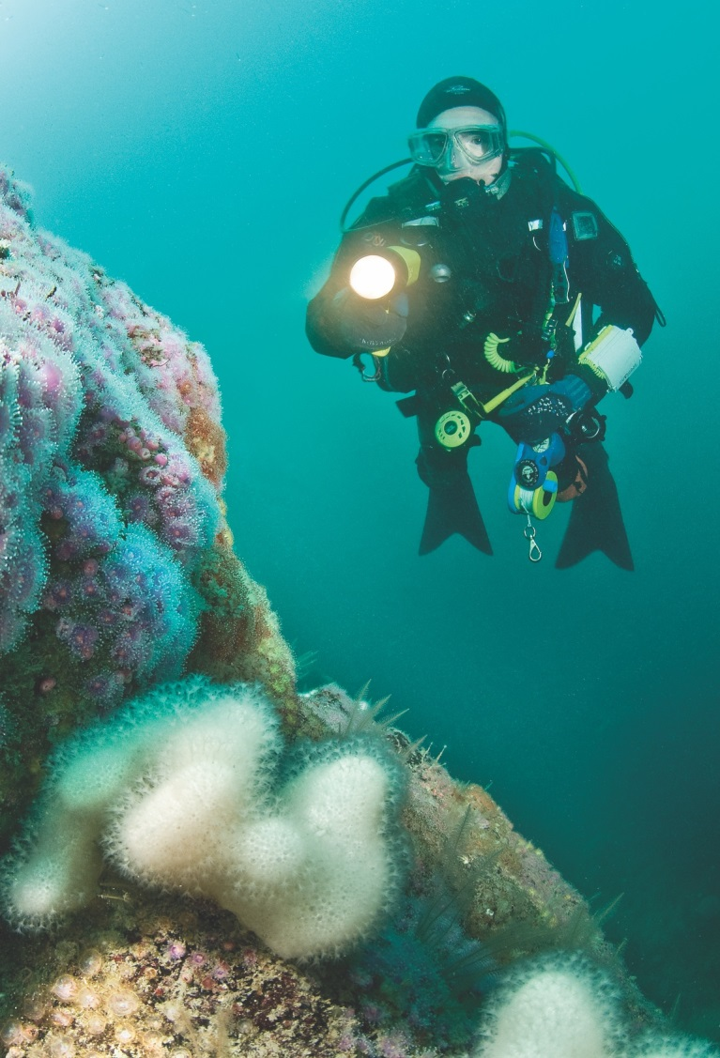
Progressing your diving
Go diving
  Have fun
  Gain experience
  Develop skills
  Increase confidence and awareness
  Dive with different people
Further training
  Sports Diver qualification
  Skill Development Courses (SDCs)
    Buoyancy and trim workshop
    Marine life appreciation
    Wreck appreciation
    Boat handling
    And many other courses

Slide 22
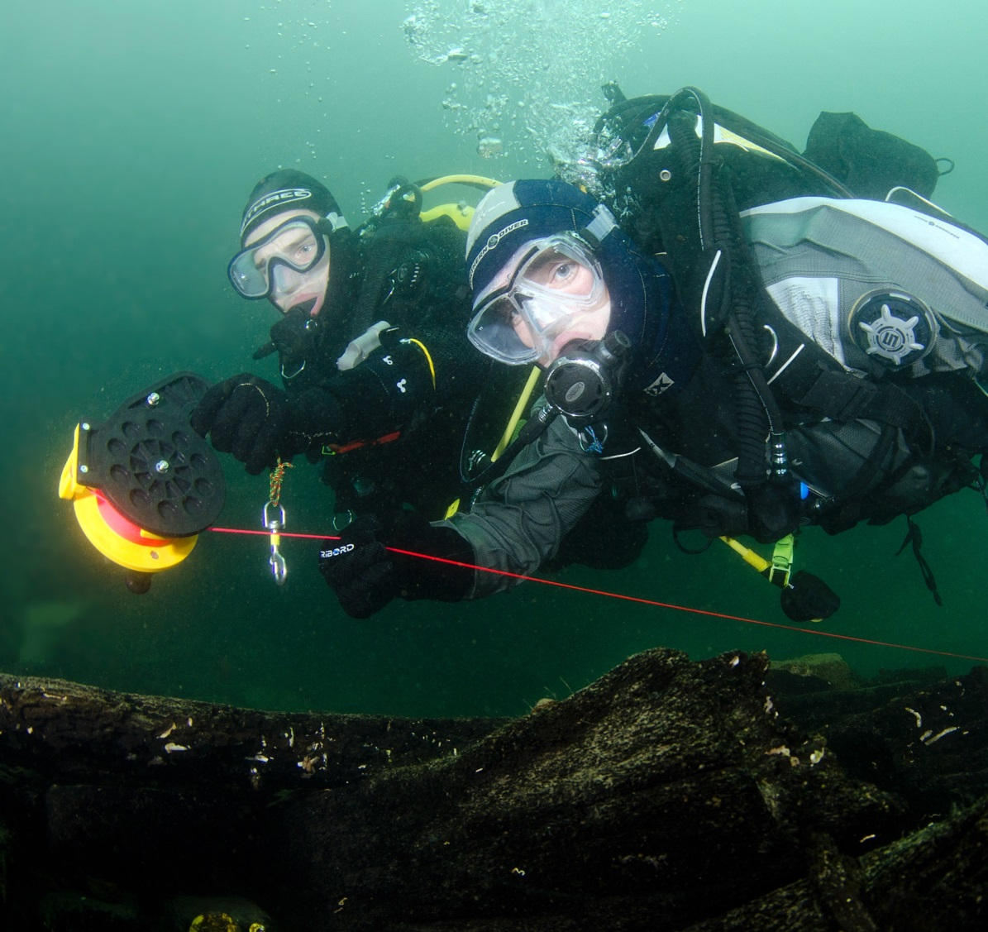
Expedition diving
BSAC encourages fully trained divers to
  Dive with their branch, region or centre
  Organise challenging and interesting diving
Dive with a purpose
  Participate in research projects
  Learn more about marine environment
  Be safe

Slide 23
Quiz 2
What extra precautions should you take when diving a wreck?
  Take a knife / line cutter
  Ensure good buoyancy and finning techniques
What extra precaution should you take when conducting a night dive?
  Take a torch and back-up light

Slide 24
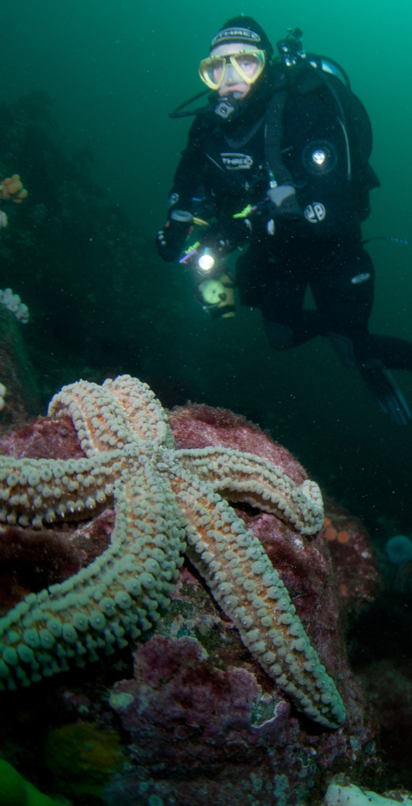

Summary
Module OT6
Different dive sites
  Inland and sea diving
  Local diving conditions
Different dive platforms
  Shore and boat diving
Different types of diving
  Reef, wreck and night diving
Responsibilities
  Marine conservation
  Wreck protection
Know how to plan
  Holiday diving
  Skill progression

