Slide 1
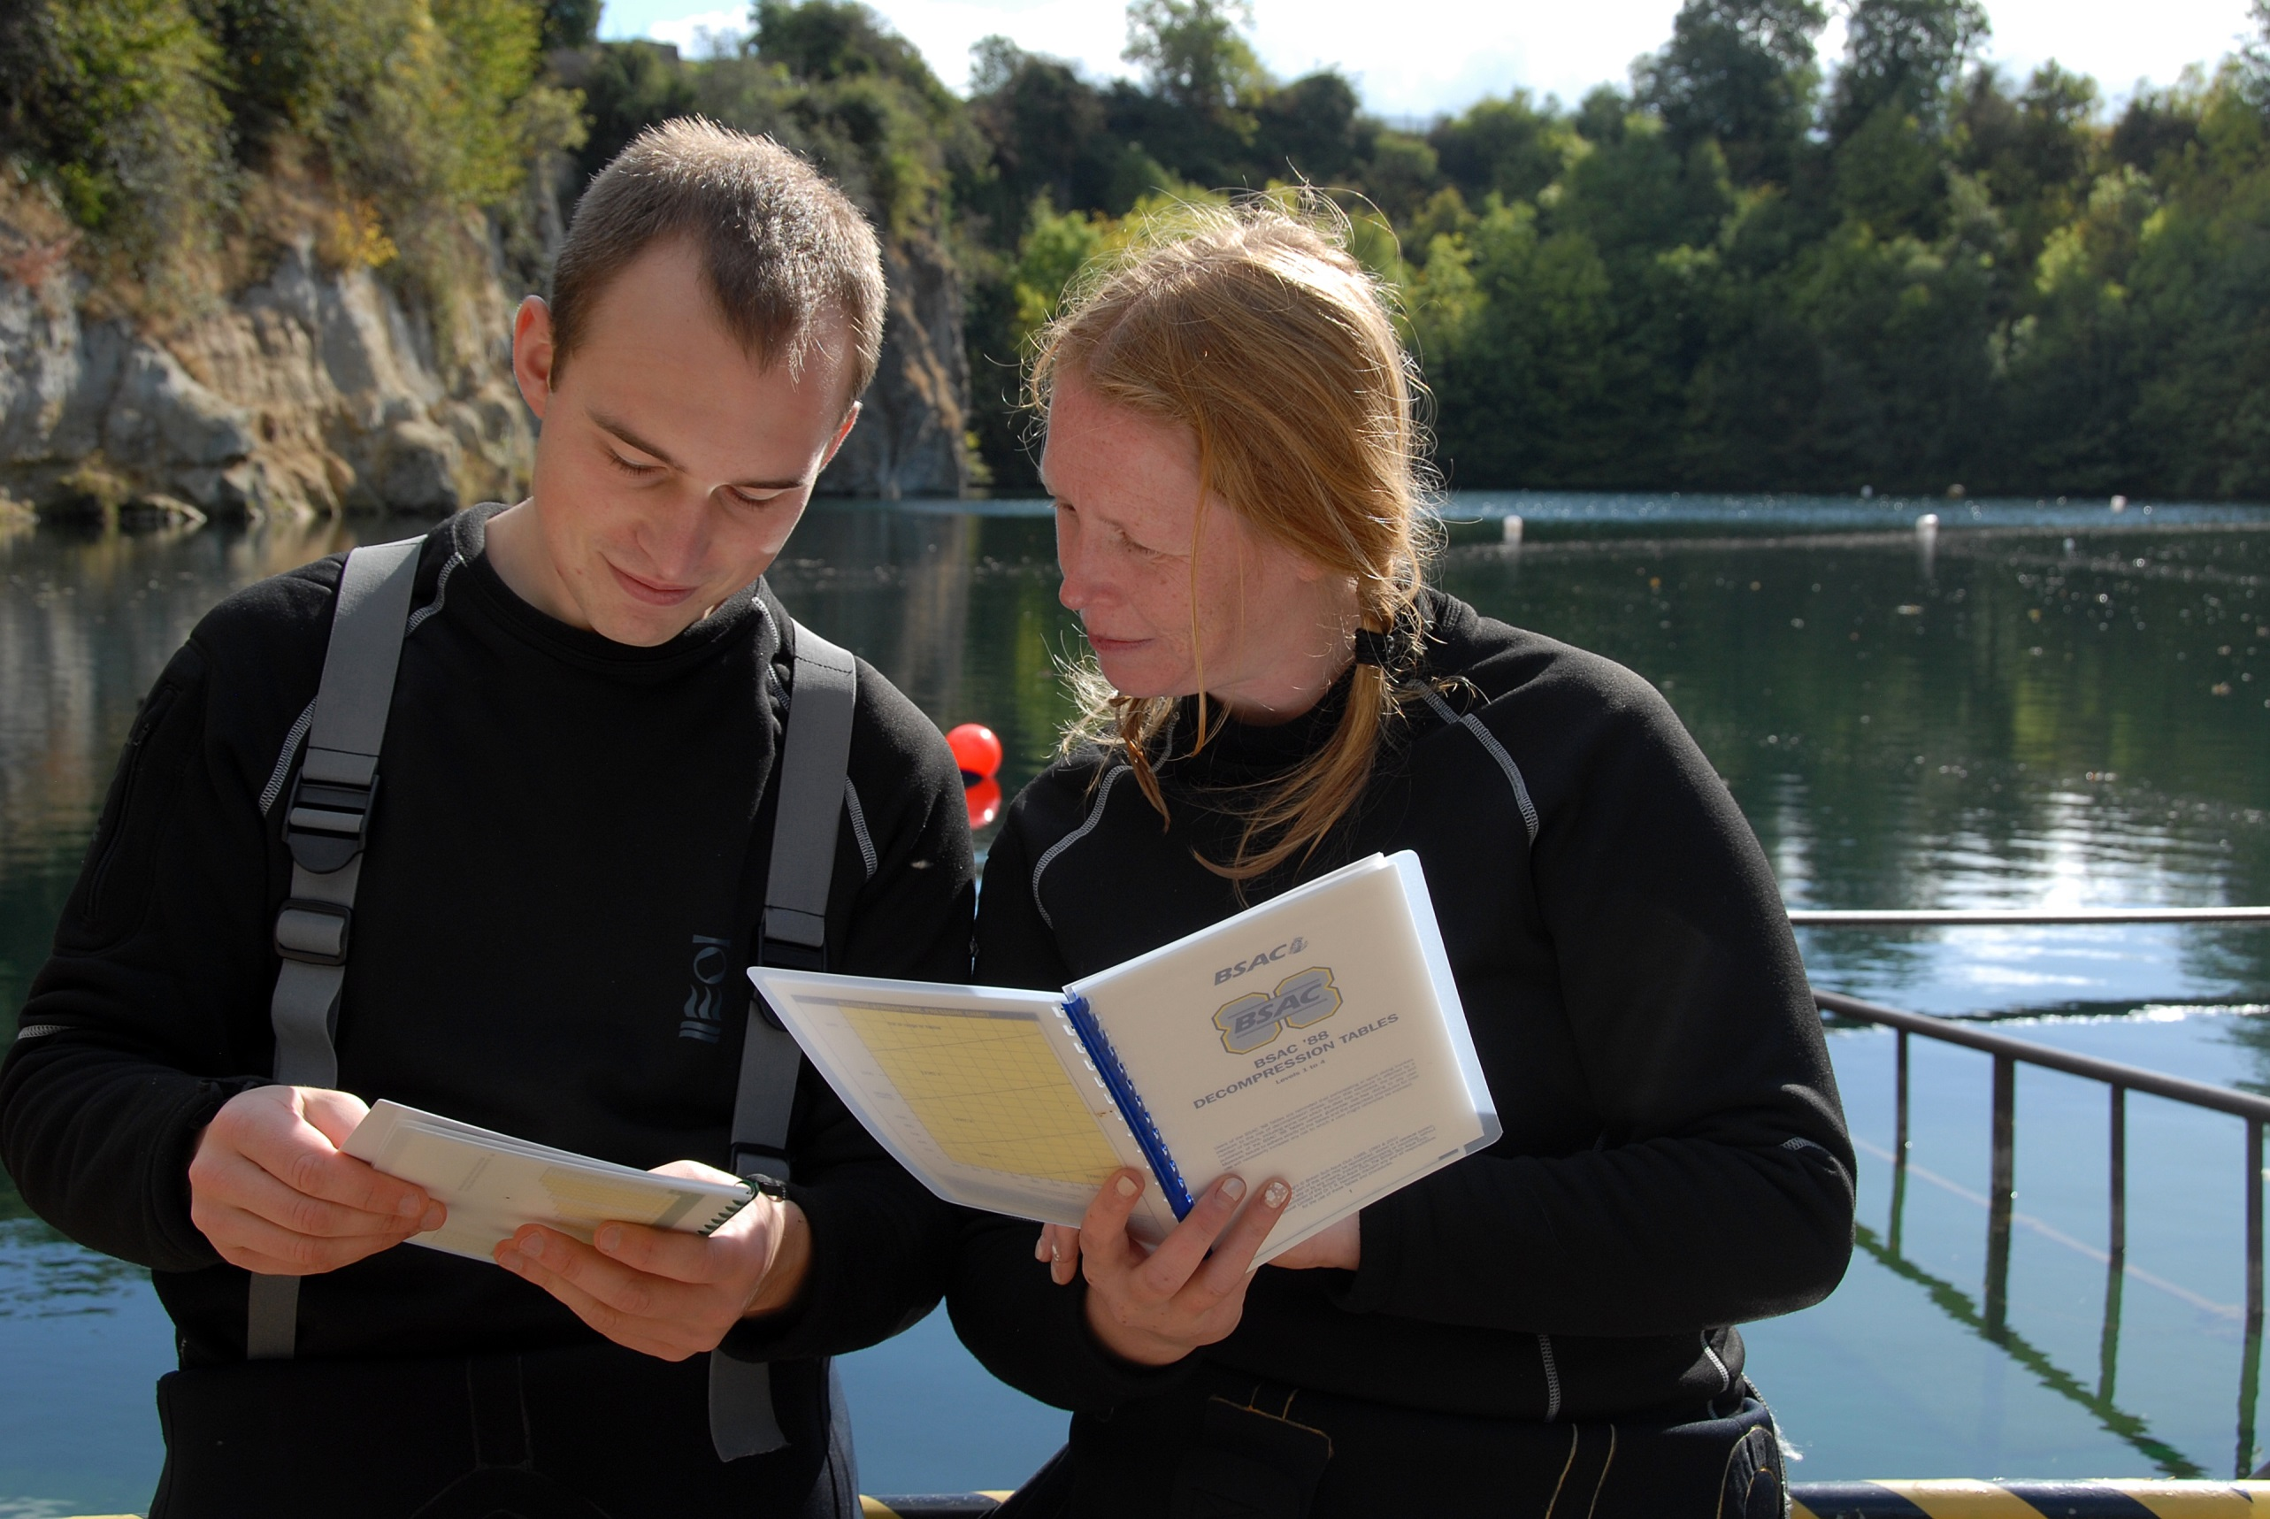

Dive planning
Module OT4
Ocean Diver

Slide 2
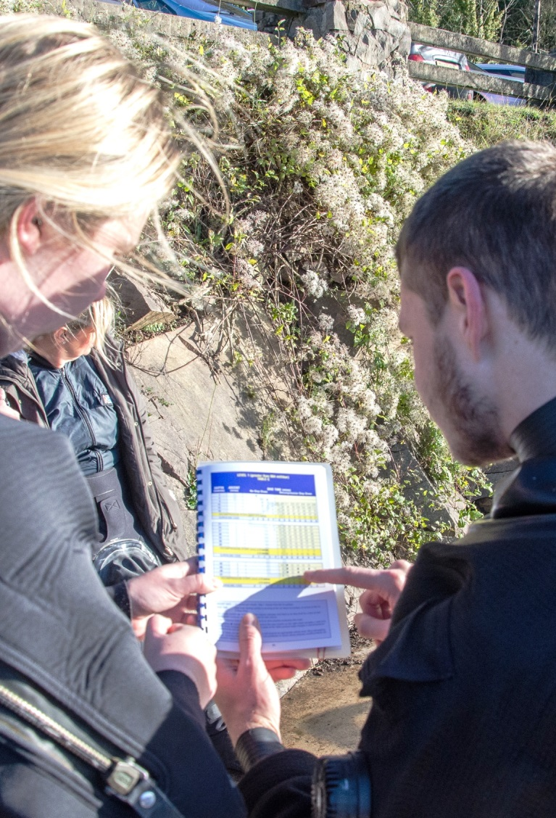
Module content
The practicalities of dive planning
  Decompression planning
  Dive instruments
  Differences between tables and computers
  Altitude and diving
  Flying and diving
  Oxygen toxicity limits
  Gas consumption planning

Slide 3
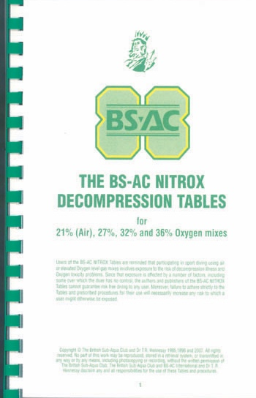
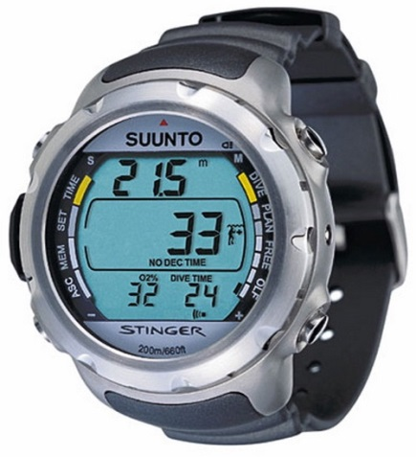
Decompression planning
DCI avoidance
  Nitrogen management
  Plan dive depth and duration
  Use dive tables or computer
Using nitrox
  Less nitrogen means reduced risk of DCI
  Ocean Divers may use nitrox mixes up to 36%
Dive tables
  Understanding the principles of BSAC tables will help you understand dive computers

Slide 4
Dive tables – definitions
Depth
  Deepest depth reached during the dive in metres
Descent rate
  Maximum is 30m/minute
Ascent rate
  Maximum is 15m/minute up to 6m
  Take one minute from 6m to the surface
Ascent check depth
  At 6m pause to check dive time and depth
Dive time
  From leaving surface, to arriving at 6m
6m
Deepest depth
6m
Dive time

Slide 5
Dive tables – tissue codes
Current tissue code (CTC)
  Represents your current nitrogen saturation
  Starting point for dive planning
Surfacing code (SC)
  Represents your nitrogen saturation at end of dive
On the surface after a dive
  Continued ‘off-gassing’ reduces tissue nitrogen loading
  Surface interval reduces CTC
  Gives new CTC for a second dive
CTC
SC
Tissue Codes : A B C D E F G
Nitrogen Load

Slide 6
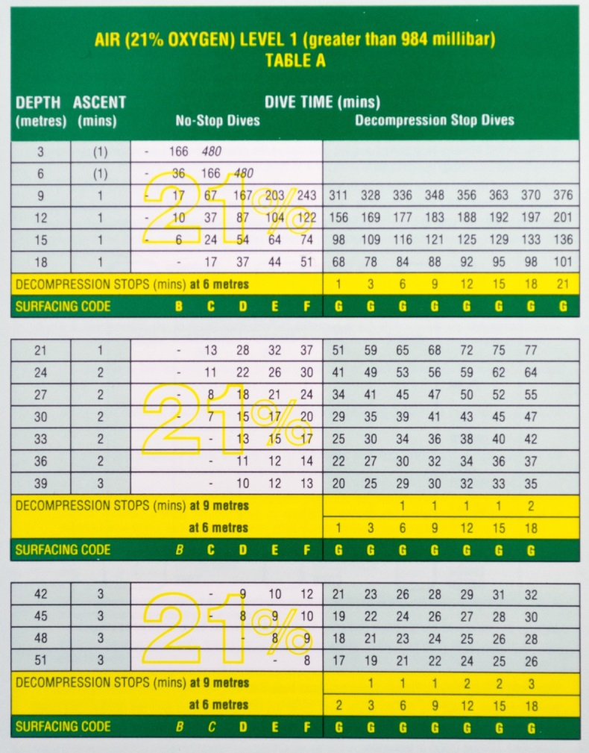
Dive tables – single dive planning
Ocean Divers
  Maximum depth 20 metres
  No-stop dives for minimum risk – use the white zone
  Dive up to nitrox 36% , plan on air tables for minimum risk
  Table A for divers with a CTC of A
Example
  Dive to 9m for 17 min.
  Surfacing code is B
  If time or depth between values use next longer time/next deeper depth

Slide 7
Quiz 1
What is dive time?
  Time from leaving the surface, to arriving at 6m
What is your surfacing code after your first dive of the day to 20m for 30 minutes?
  E
What is your surfacing code after a first dive to 12m for 40 minutes?
  D

Slide 8
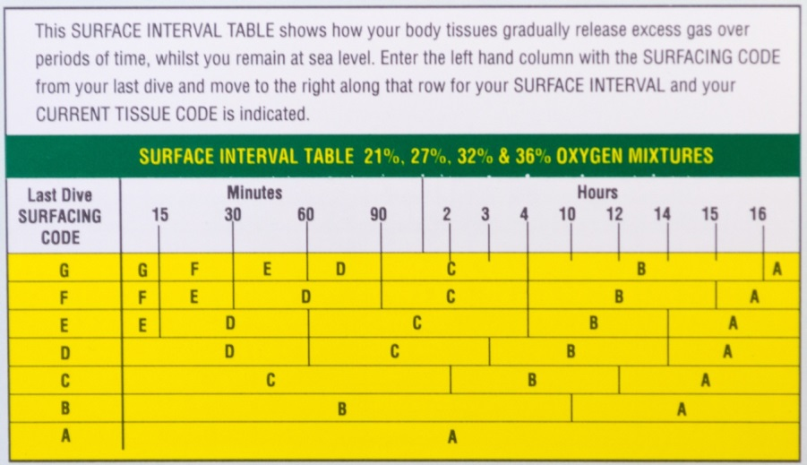
Dive tables – surface interval
Surface interval table
To find your CTC for a second dive
  Enter at your SC
  Move across to your surface interval
  Read new CTC from table
Example
  SC = E
  Surface interval = 5 hours
  New CTC = B
  Use table B for planning

Slide 9
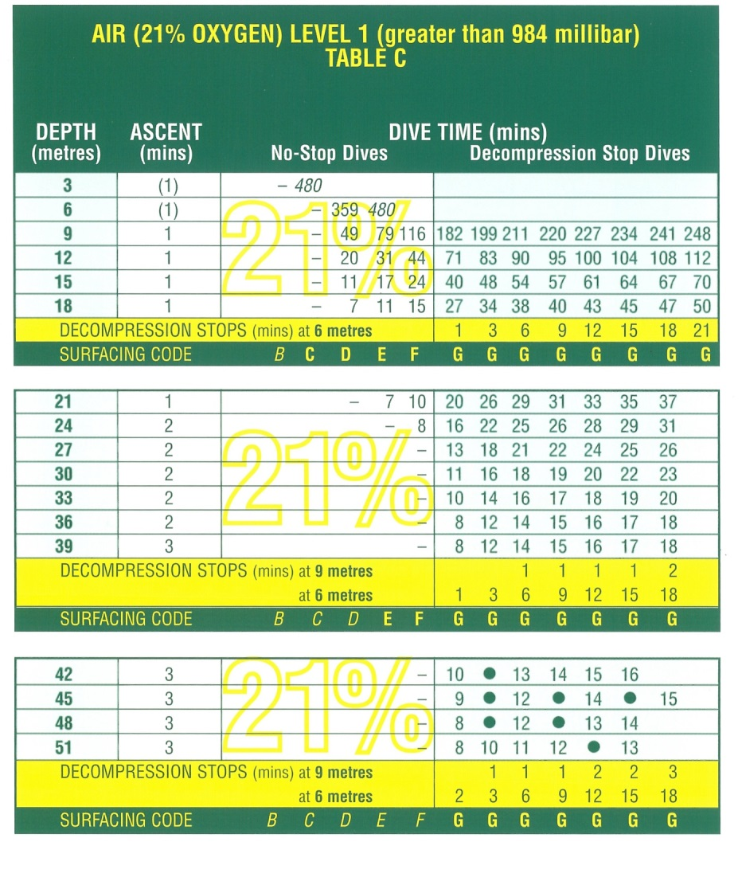
Dive tables – repeat dive planning
Plan second dive shallower than first
  Select table that matches your CTC
  Select depth
  Read off dive time
Example
  CTC = C = Table C
  Want to dive to 15m
  Max dive time is 24 min
  Surface code will be F

Slide 10

Dive instruments
To dive the plan made using tables you need
  Depth gauge
  Watch
  Dive slate
  Gas analyser (nitrox mixes)
Plan the dive and dive the plan

Slide 11
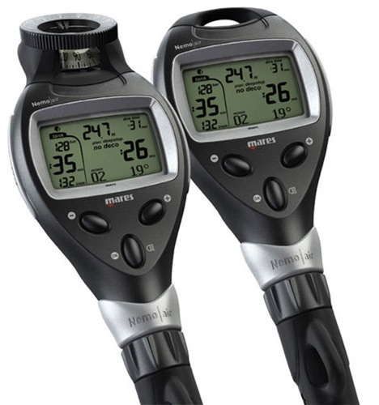
Dive computers
Computer functions
  Calculate nitrogen loading
  Provide planning information (depth and time)
  Allow personal risk settings
  Record depth, time and temperature
  Give audible and screen warnings
  Log previous dives

Slide 12
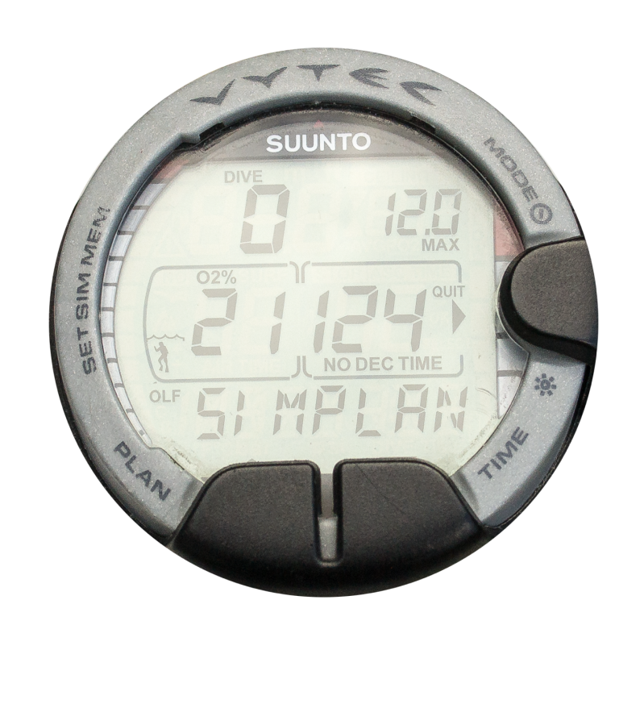
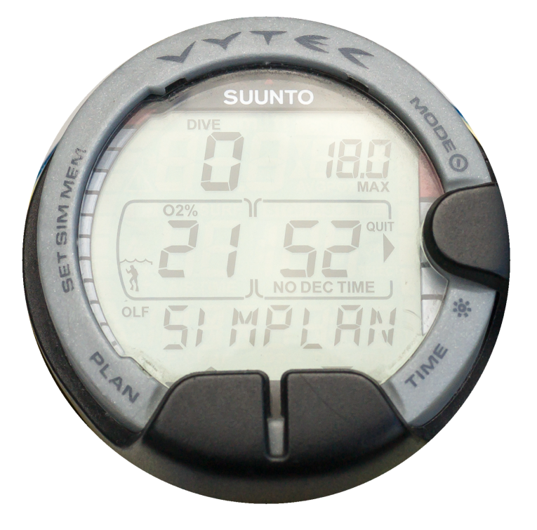
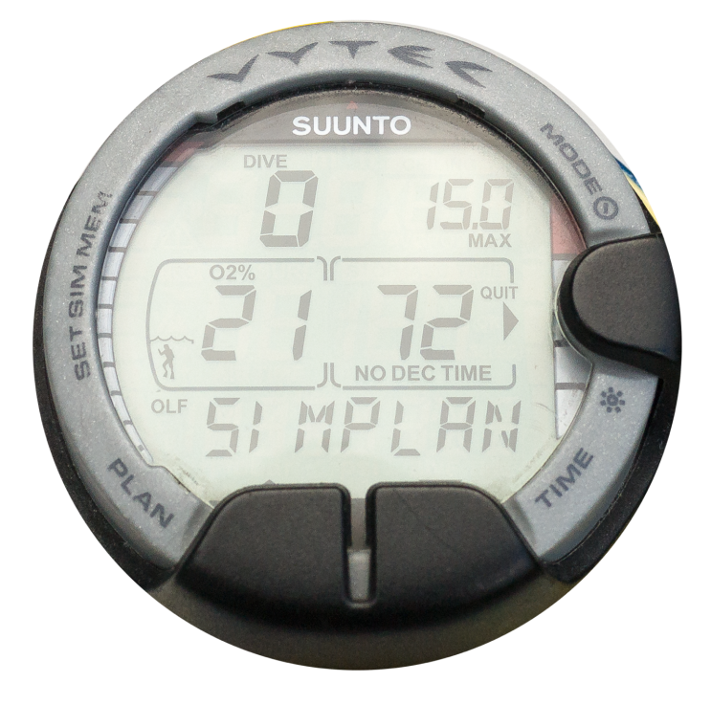
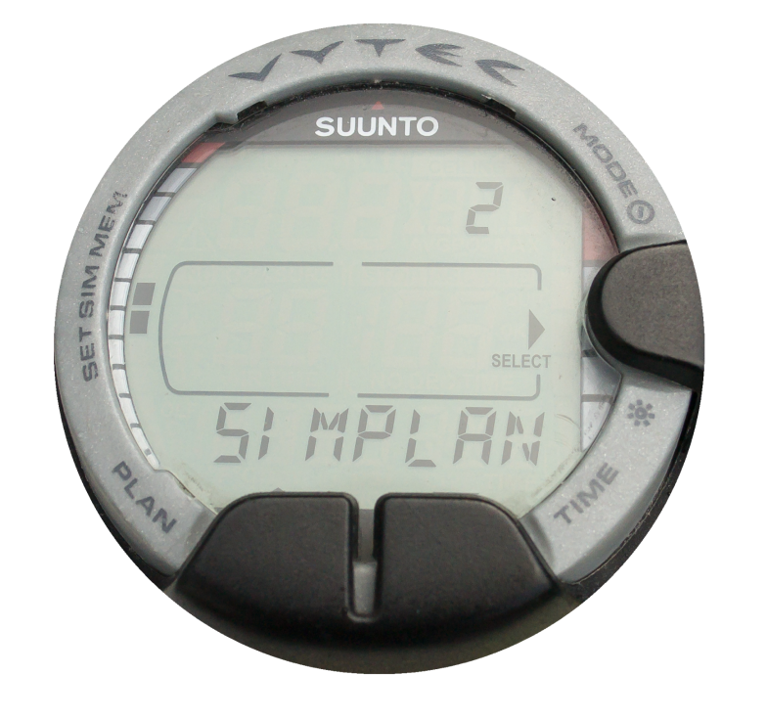
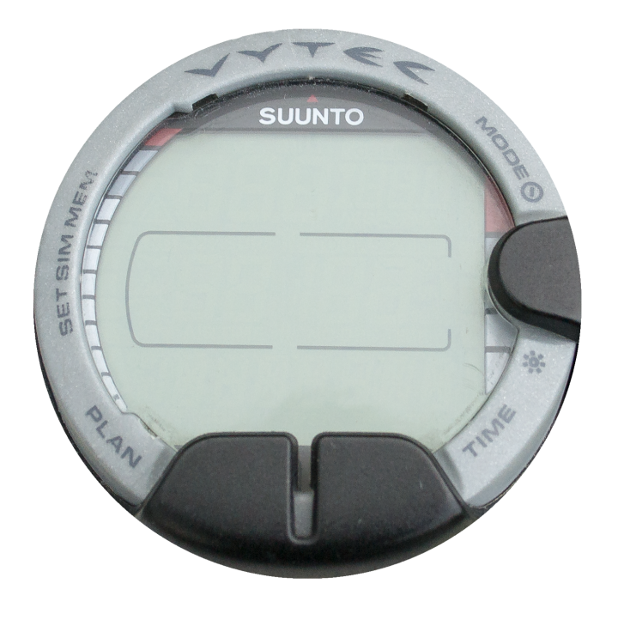
Dive computers – dive planning
Single dive planning
  Read instruction manual
  Switch on and select planning mode
  Set planned depth and look up
  no-stop time
  ‘Little longer’ or ‘little deeper’
  Use a slate to record the plan
Repeat dive planning
  Computer knows surface interval
  Repeat as single dive planning
  Computers are linked to a single diver
Plan the dive and dive the plan
PRESS
PRESS
PRESS
PRESS

Slide 13
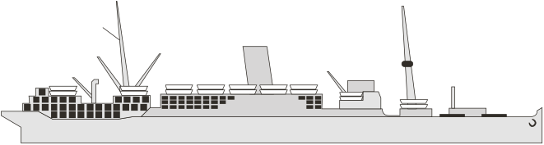
Tables versus computers
Different dive profiles
  Dive tables: ‘square’ profile based on maximum depth
  Dive computers: variable or multi-level profile
  Dive computers: more data in real time

Slide 14
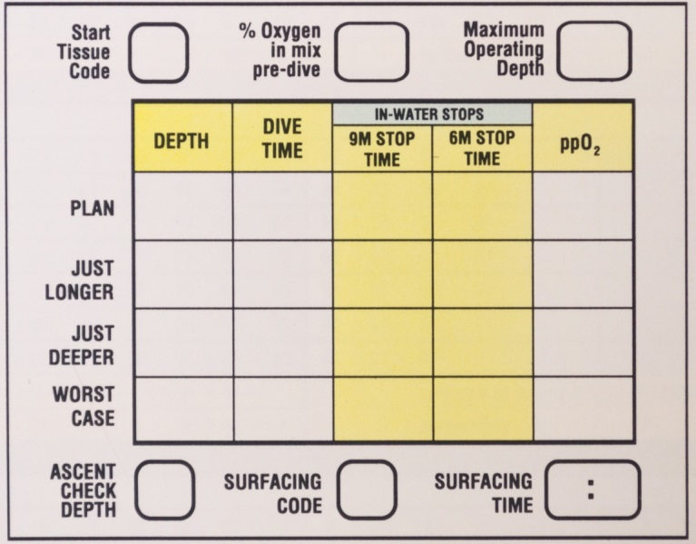
Dive plans
Whether using tables or computers
  Do the deepest dive first
  Never push the limits of tables or computers
  Start deep and progress to the shallows
  BSAC tables allow for 3 dives in 24 hours
  Computers may have similar limits
Buddies may have different profiles
  Adhere to the most conservative profile

Slide 15
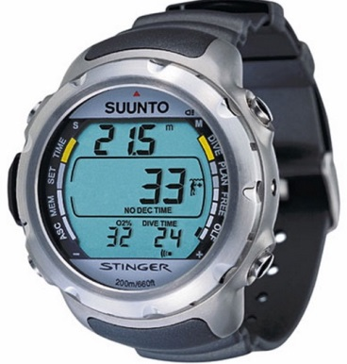
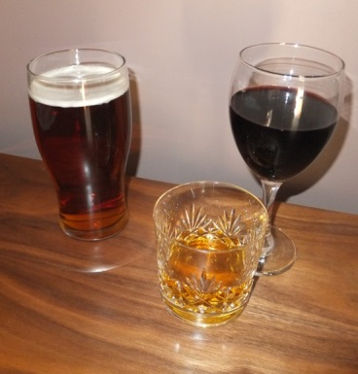
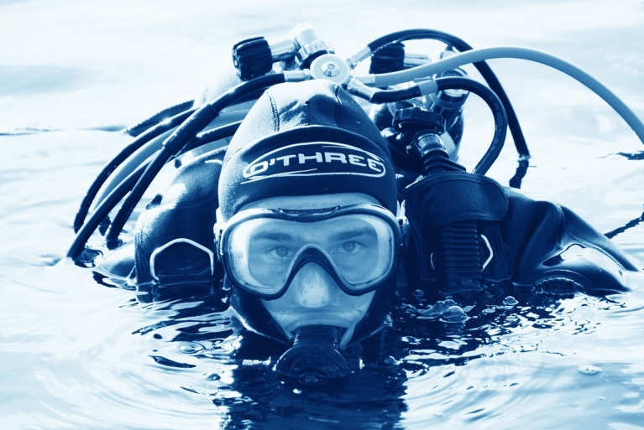
Limitations of tables and computers
Tables and computers
  Both minimise risk of DCI but not infallible
DCI risk factors
  Cold
  Alcohol/drugs
  Poor buoyancy control
  ‘Saw-tooth’ profiles
Individual susceptibility
  Fitness
  Exertion
  Dehydration
  Pre-dispositions

Slide 16

Altitude and diving
Table levels
  Level 1 tables for sea level
  Levels 2, 3 and 4 for altitude
  Require additional training
When to use other levels
  Travelling - hills and mountains
  Living or diving at altitude
  Inland sites in bad weather
  Flying
Computers and altitude
  Read instruction manual

Slide 17

Flying and diving
Flying before diving
  Tissues off-gas
  Stresses of flying
  Recover before diving - 10 hours minimum
Flying after diving
  Increased level of off-gassing – DCI
  Stresses of flying
  Ensure long surface interval between last dive and flying
  Tables require CTC of A or B
  Computers – follow instructions

Slide 18
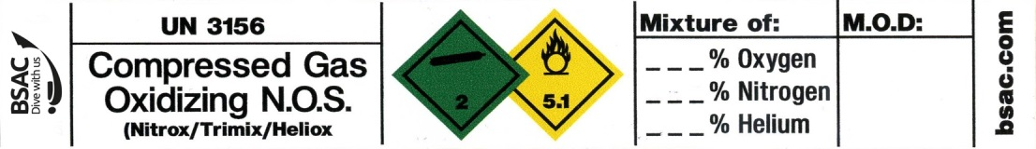
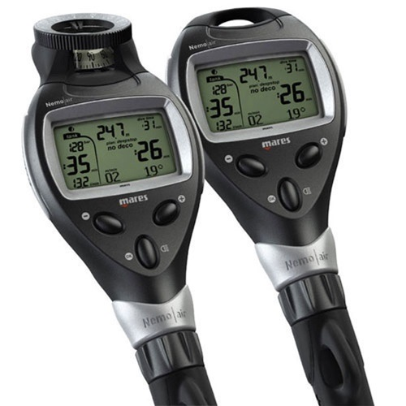
Oxygen toxicity
Nitrox
  Reduces DCI risk but increases oxygen toxicity risk
  Ocean Diver should not exceed 20m
Dive computer settings
  Set to air to reduce DCI risk
  Using nitrox setting increases dive time and increases DCI risk

Slide 19
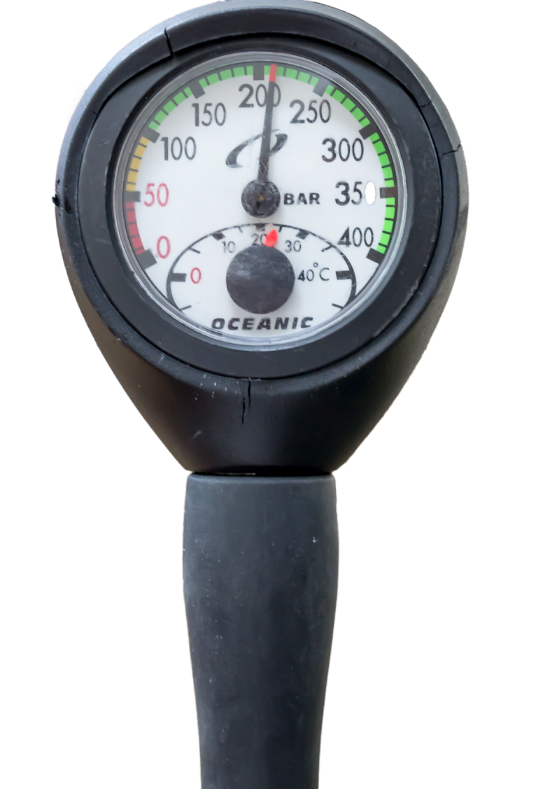
Gas consumption planning
Gas planning
  Ensure sufficient gas for the dive
  Ensure good reserve
Rule of thirds
  Use one-third out
  Use one-third return
  Keep one-third in reserve

Slide 20
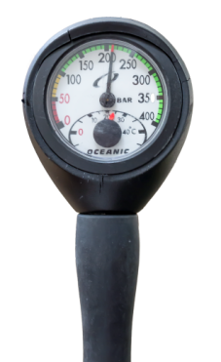
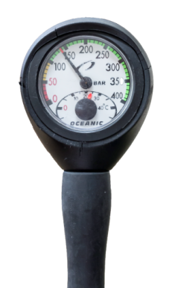
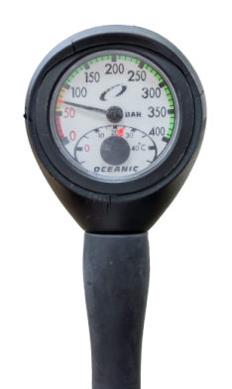
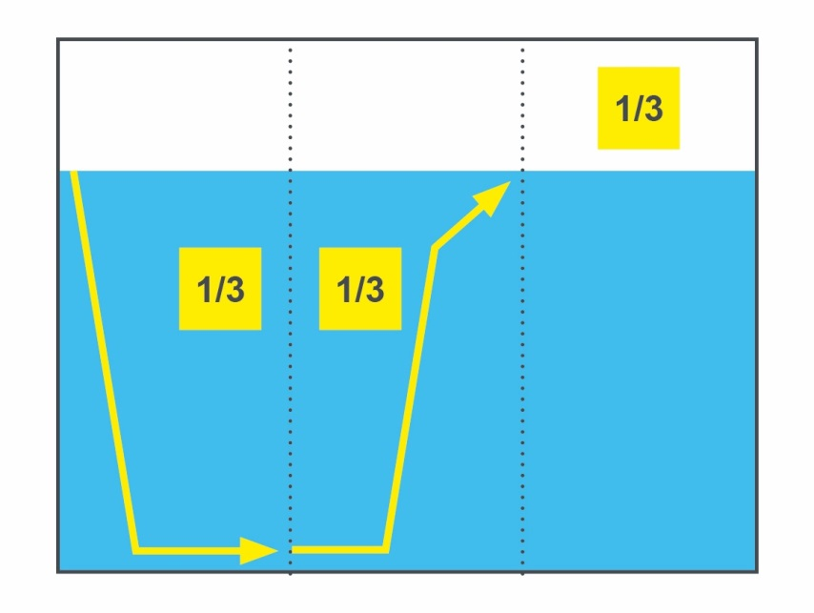
Rule of thirds
Example:
  Cylinder start pressure
    210 bar
  Cylinder pressure at turn around / half way point
    140 bar
  Cylinder pressure at surface
    70 bar as reserve
Always aim to surface with 1/3 of your gas in reserve
  50 bar should an absolute minimum reserve

Slide 21
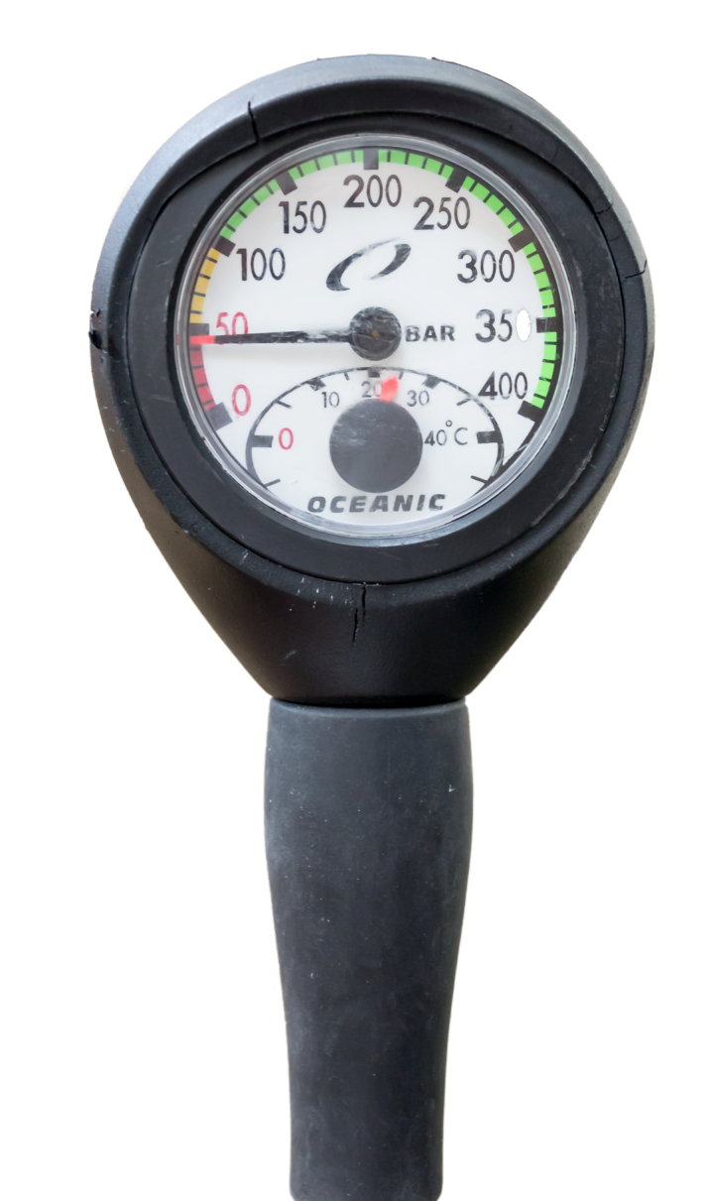
Gas monitoring
Regularly monitor your contents gauge – it is your lifeline
  Running low or out of gas should not arise under normal diving conditions
Gas consumption increases when
  Physical effort increases
  Divers are cold or anxious
Shorten or terminate the dive

Slide 22
Quiz 2
How deep can an Ocean Diver go on 32% nitrox?
  20m
How much gas should be held in reserve?
  1/3 but not less than 50 bar
What are the risk factors for DCI?
  Poor buoyancy control
  Cold
  Dehydration
  Alcohol/drug consumption

Slide 23
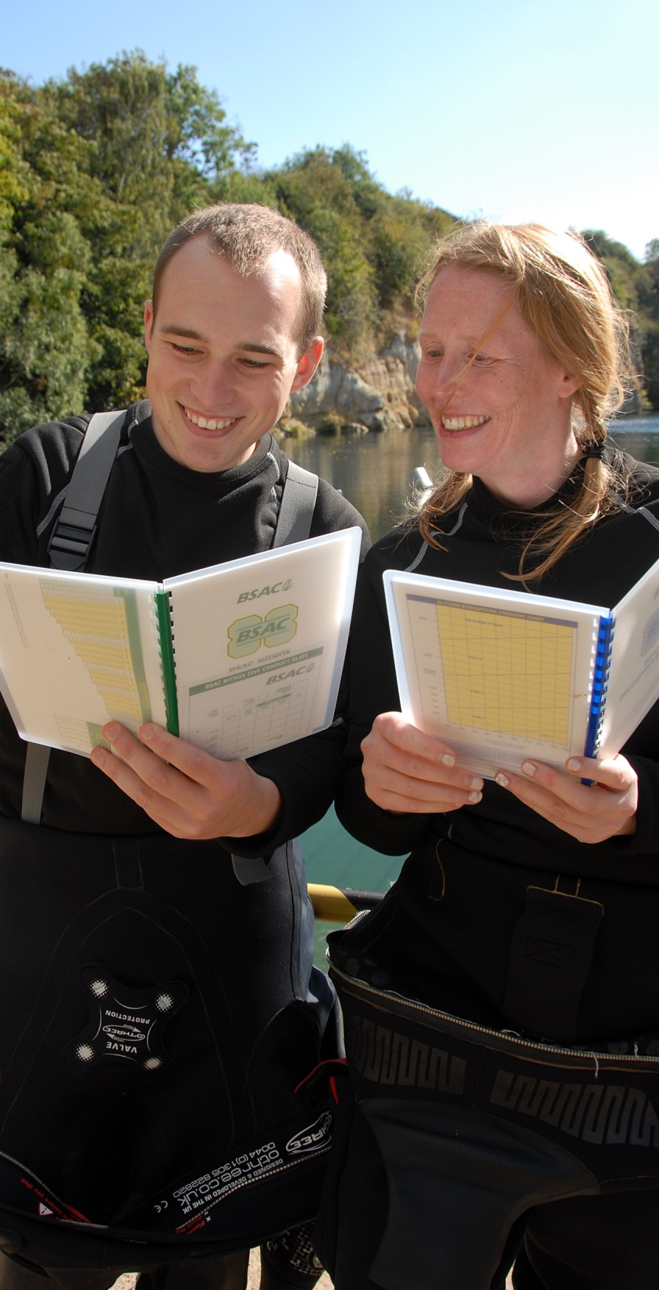

Summary
Module OT4
The practicalities of dive planning
  Decompression planning
  Dive instruments
  Differences between tables and computers
  Altitude and diving
  Flying and diving
  Oxygen toxicity limits
  Gas consumption planning

