Slide 1
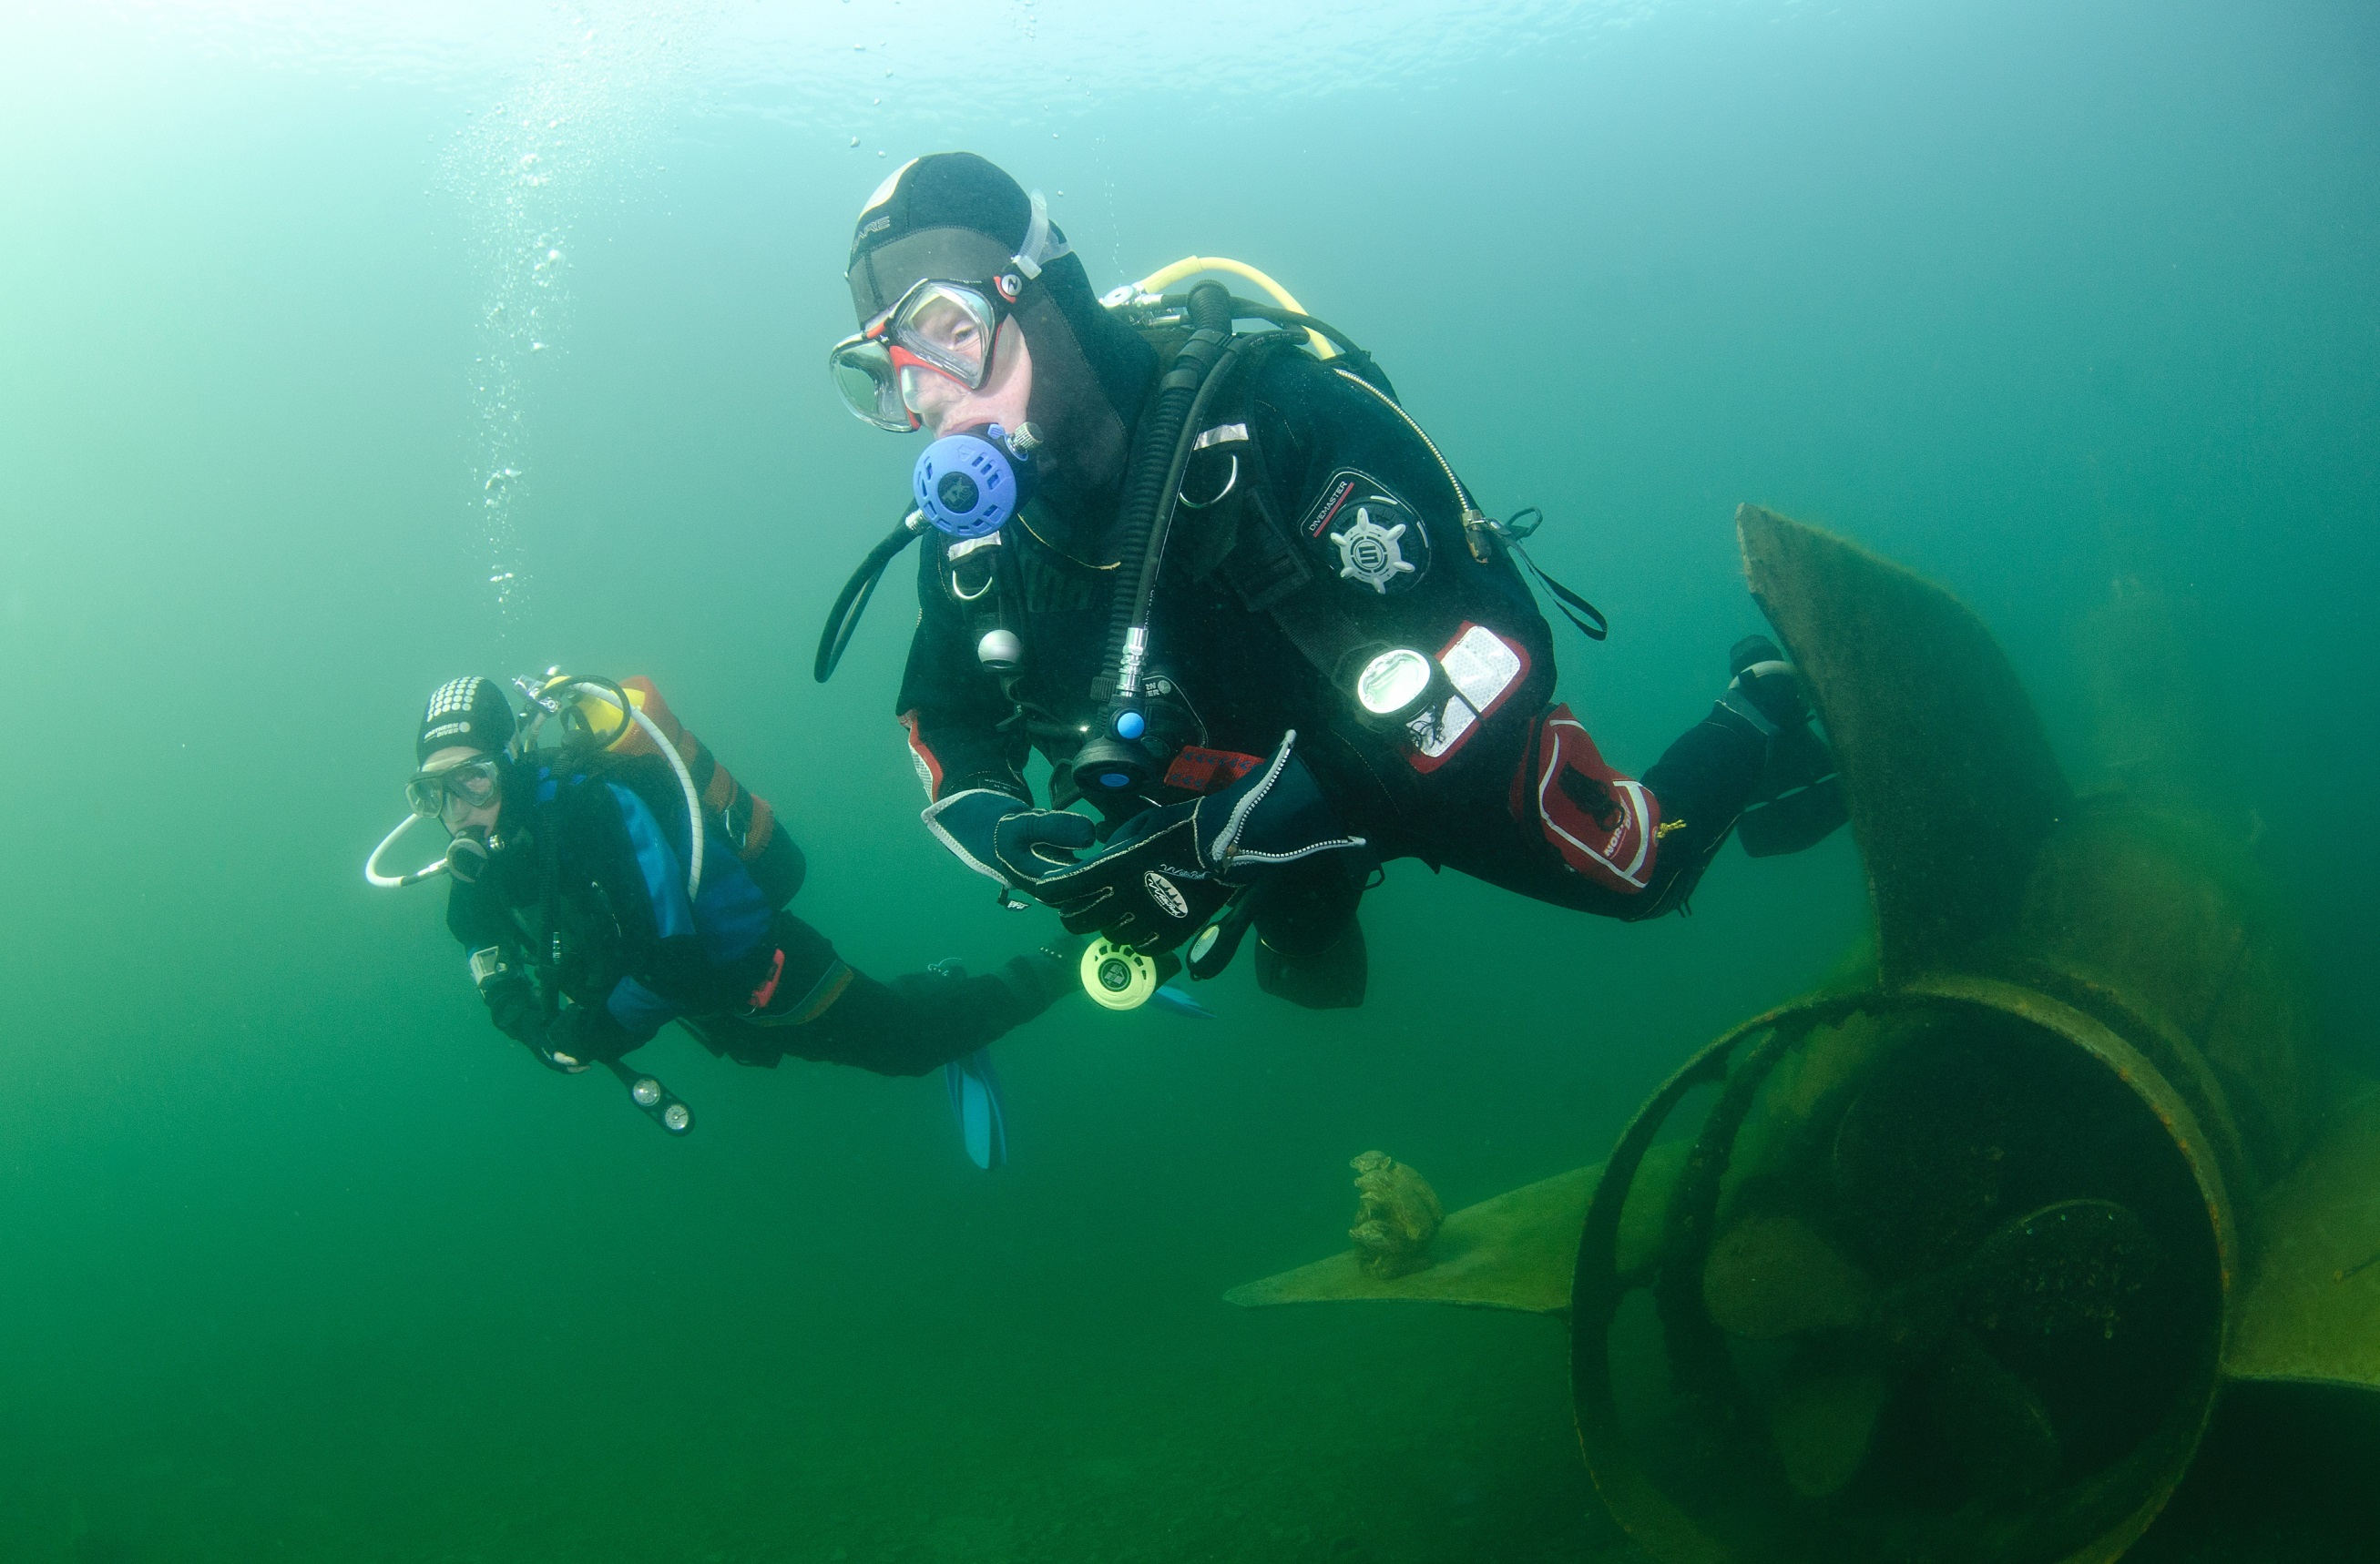

Going diving
Module OT3
Ocean Diver

Slide 2
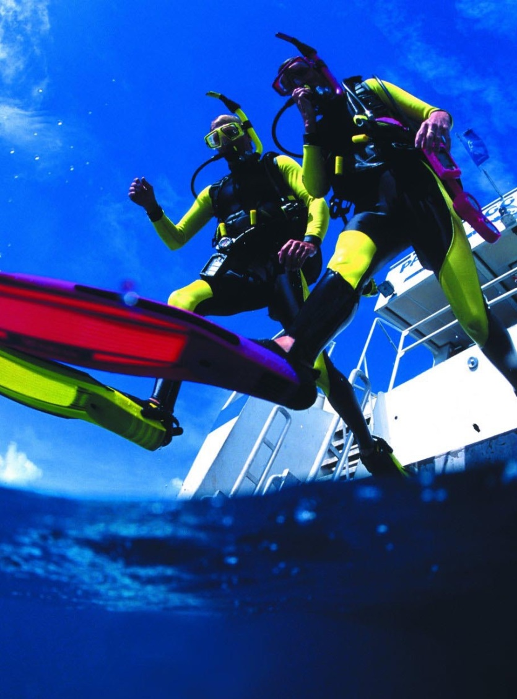
Module content
The practicalities of going diving
  Keeping safe
  Buddy diving
  Dive management
  Dive planning
  Diving signals
  Going on a dive
  The environment underwater

Slide 3

Keeping safe
Identify hazards, such as
  Running out of gas
  Separation
  Entanglement
Plan controls
  Gas monitoring
  Keep close
  Carry knife/net cutters
  Follow safe diving practices

Slide 4
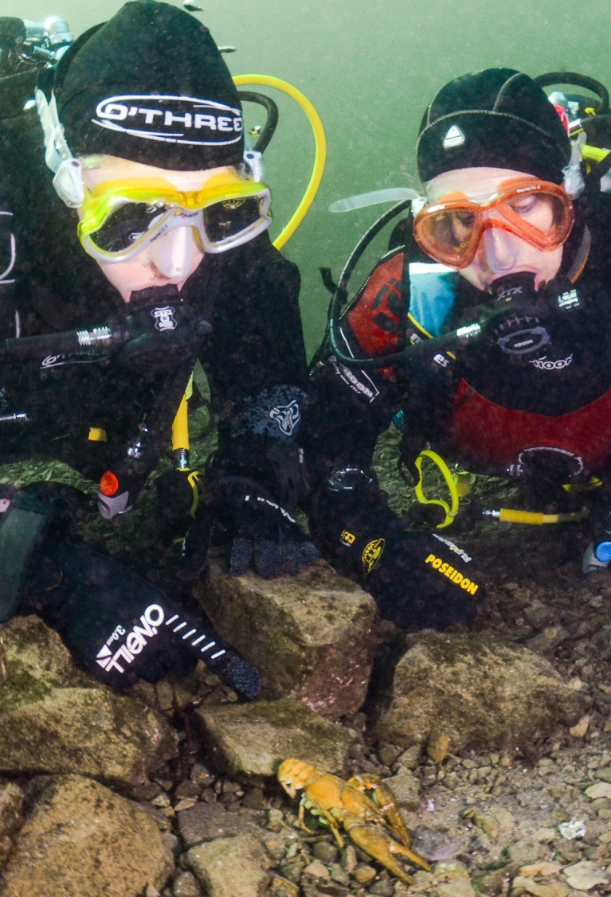
Buddy diving
The benefits of buddy diving
  Monitor each other and assist if necessary
  Help with kitting-up, entry,
  exit and de-kitting
  Develop diving skills with more experienced buddies
  Share, compare and learn from diving experiences
  Discover the type of diving you enjoy
Increased safety and enjoyment

Slide 5


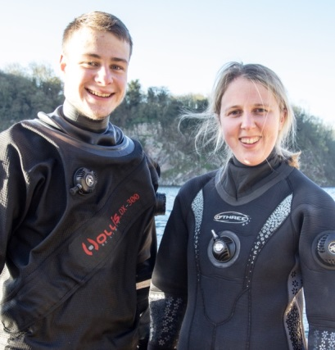
Dive organisation
Diving Officer (DO)/Lead Instructor
  Overall accountability for diving safety
Dive Manager (DM)
  Appointed by DO/lead instructor
  Responsible for all diving on site
Buddy pair
  Duty of care to self and buddy

Slide 6

The Dive Manager
Responsible to the Diving Officer
Lead Instructor
  Selects the site
  Creates overall dive plan
  Gives dive brief
  Controls entry and exit
  Monitors dive progress
  Records dive details
  May ask you to assist other divers
  Manages incidents that occur

Slide 7
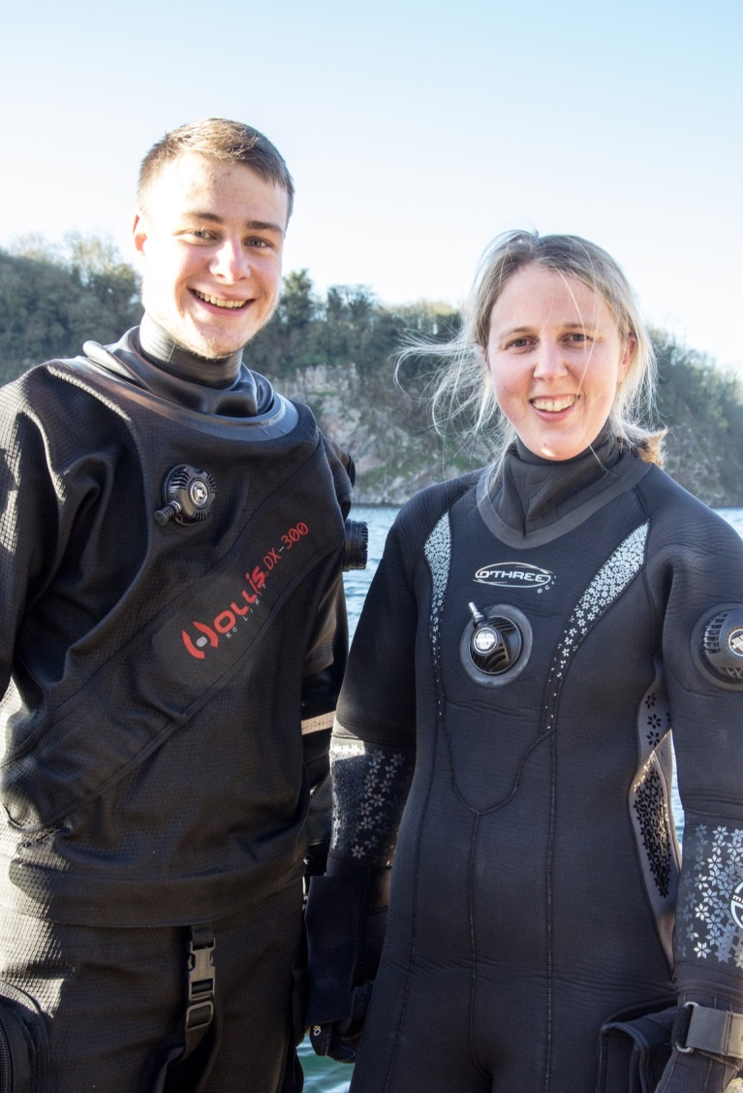
The buddy pair
Responsible to the Dive Manager
  Listen to dive brief
  Plan your dive
  Agree and lodge dive plan with DM/DO
  Be ready to enter water on time
  Dive the plan
  Lodge dive details with DM after dive
  Help other divers as requested by DM

Slide 8
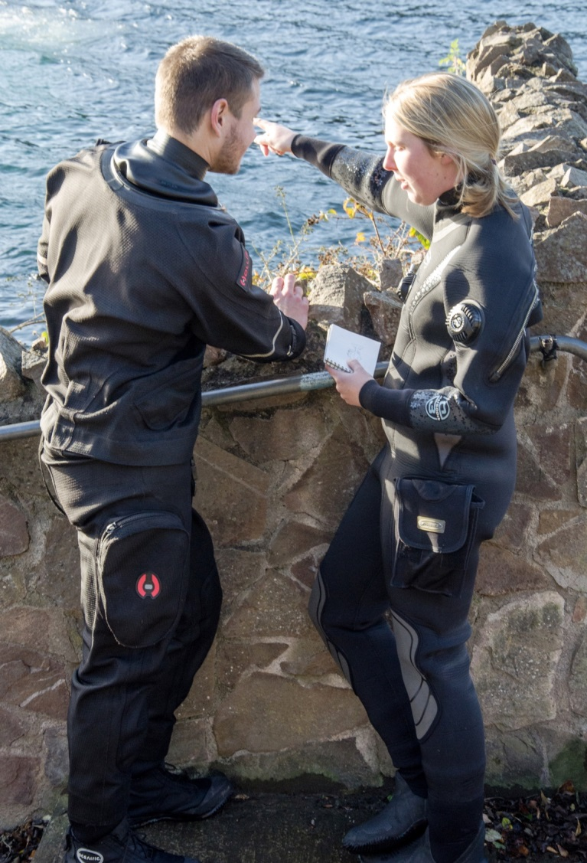
The dive plan
Dive objectives
  Training
  Experience
  Fun
Planned depth
Dive duration
  Gas use
    Surfacing with a reserve
    Rule of thirds
Managing risks
  On the surface
  Underwater conditions
  Navigation

Slide 9
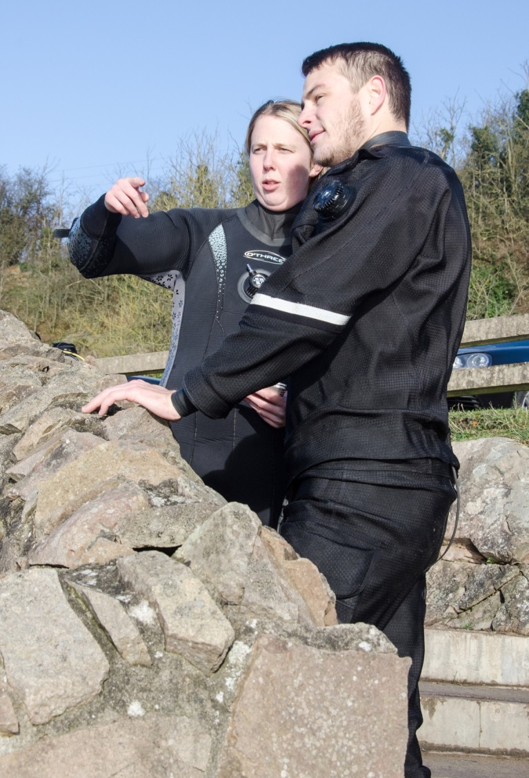
Buddy briefing
Safety
  Fitness to dive
  Within capabilities and qualifications
  Site hazards
Exercise – dive objective
  Depth and time
  Breathing gas
Equipment
  What is needed
Discipline
  Confirm dive leader
  Stay together
  Separation procedure
Signals
  Highlight any special signals

Slide 10

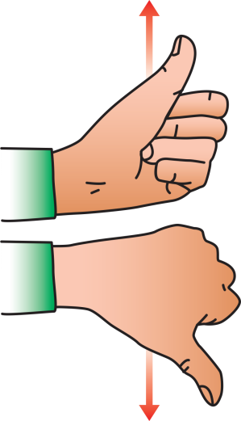
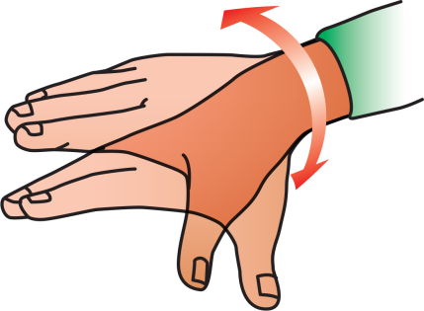
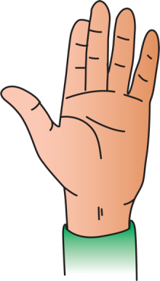
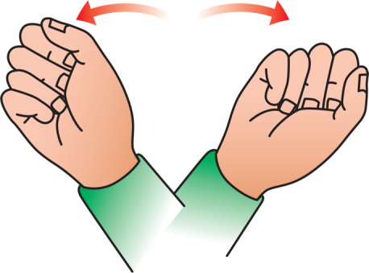
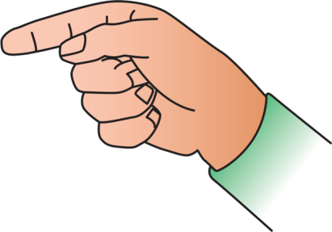
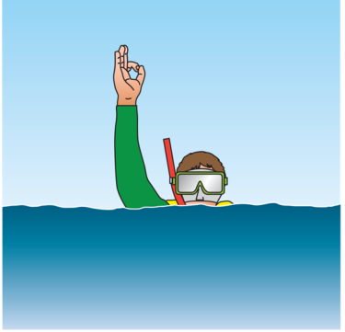
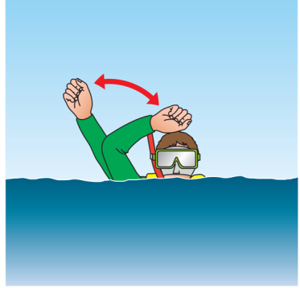
Diving signals
Basic signals
  OK
  Up
  Down
  Something is wrong
  Stop
  You or me
Safety signals
  Gas check
  Distress
  Out of gas
  Out of breath

Slide 11
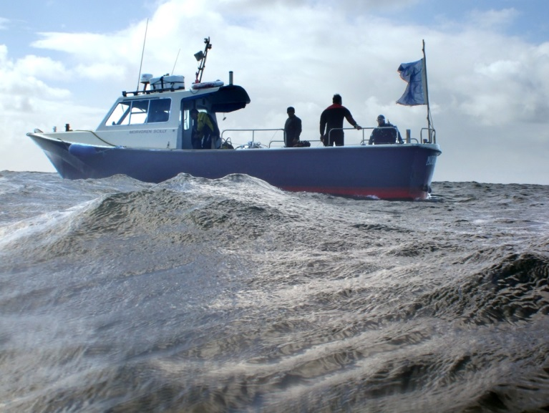

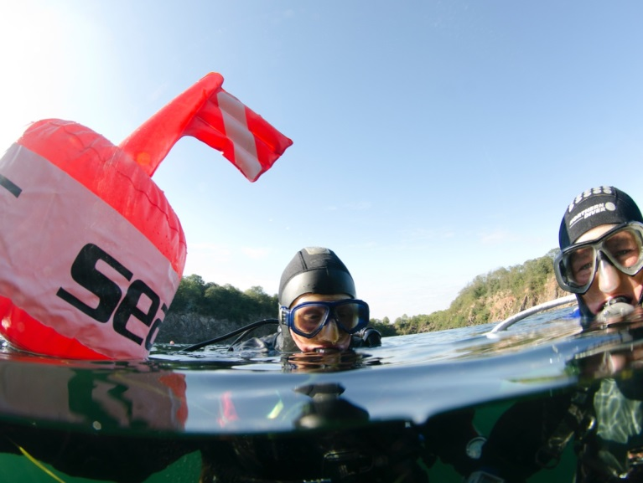

Diving signals (2)
Dive flags
  The International A flag
    Letter A in flag alphabet
    I have divers down, stay clear and reduce speed
  American Sport Divers Flag
    Divers below, stay clear

Slide 12
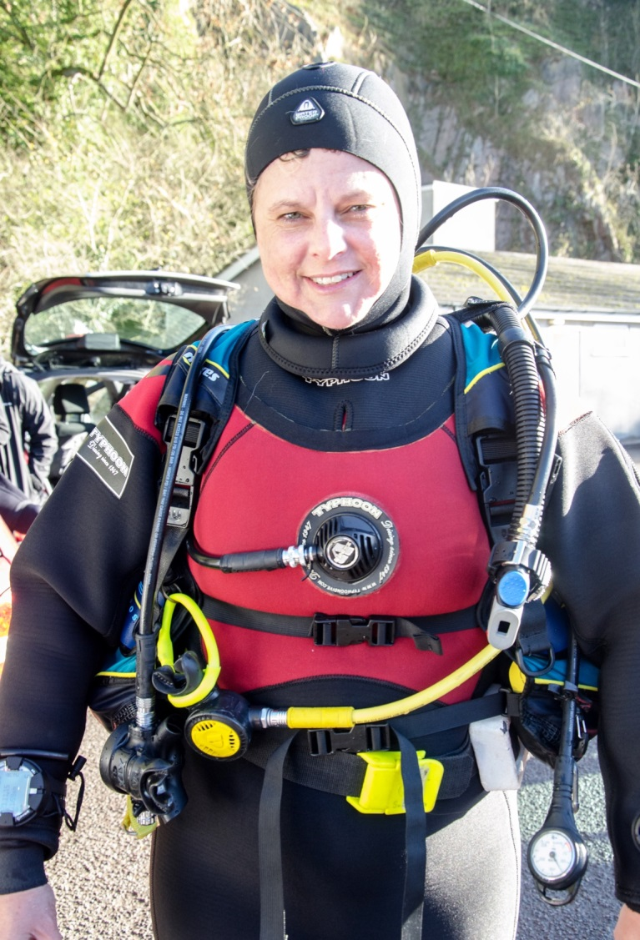
Buddy checks
Buoyancy
Buoyancy
  Direct feeds work
  Dump valves work
  Drysuit or BC?
Air (gas)
  Primary demand valve works
  Buddy to practise releasing and breathing from AS
  Gas contents
Releases
  Weight belt or weight system
  BC
  Drysuit direct feed
Releases
Gas

Slide 13
Quiz 1
What information will you get in a buddy pair safety brief?
  Safety
  Exercise
  Equipment
  Discipline
  Signals
What are the main elements of the buddy check?
  Buoyancy
  Air (gas)
  Releases

Slide 14
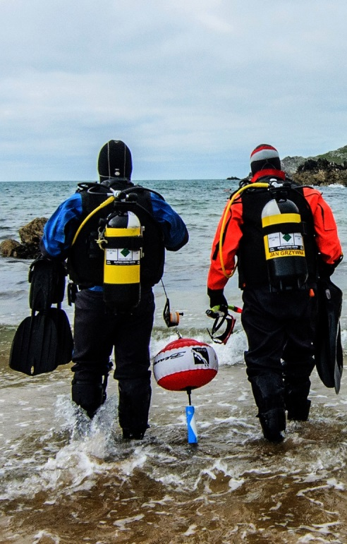
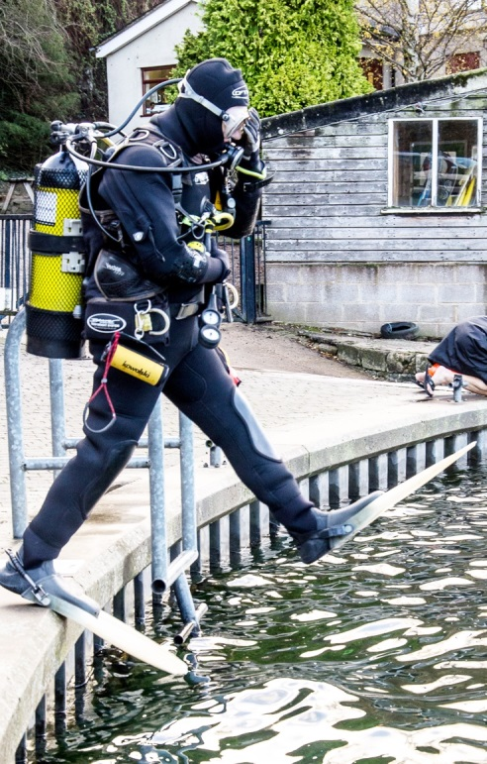
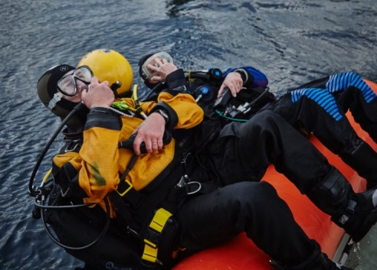
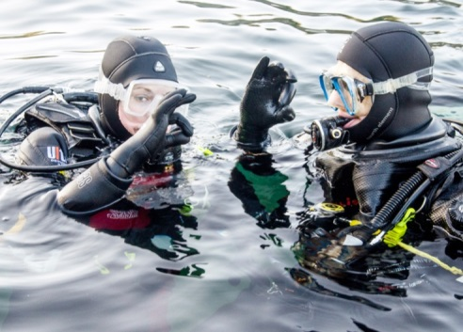
Entering the water
Shelving shore
  Wade in
  Assist with fin fitting
Large boat, some shores
  Stride or forward roll
  Sufficient water depth
  Clear of other divers
Small boat
  Backwards roll
  Clear of other divers
Following entry
  Diver to give OK to surface cover

Slide 15
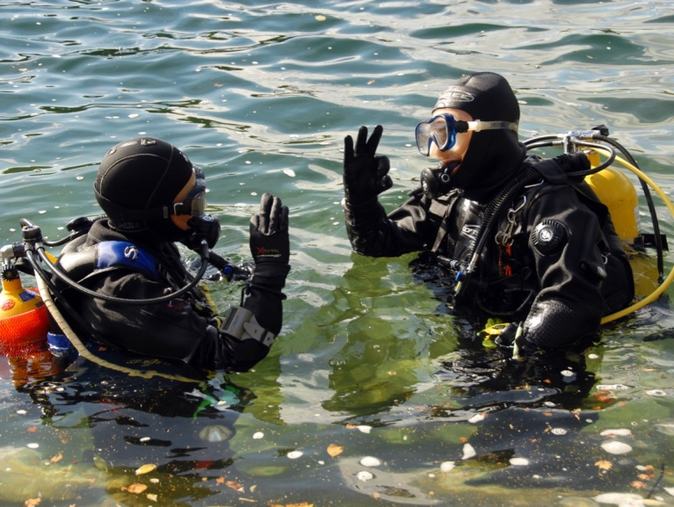
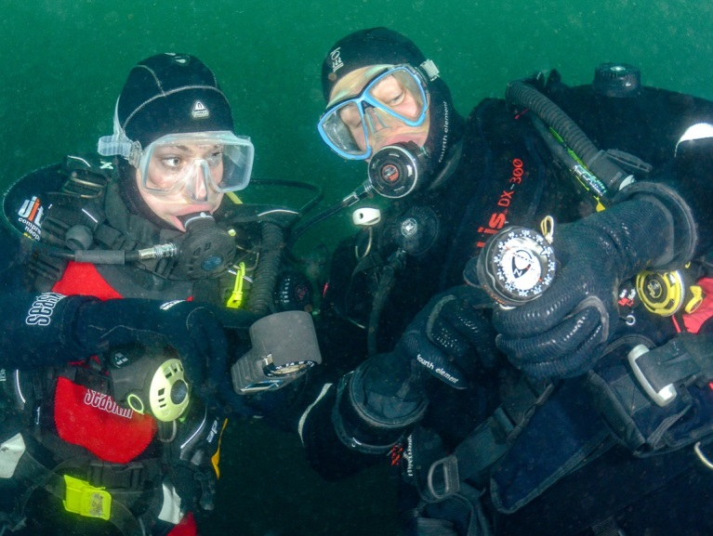
The descent
Start descent
  OK
  Down
  Stay together
  Clear ears
  Buoyancy control
A few metres down…
  Check depth gauges
  Check breathing gas
  Check buoyancy
  OK to continue?
Aim to hover before you hit the bottom

Slide 16
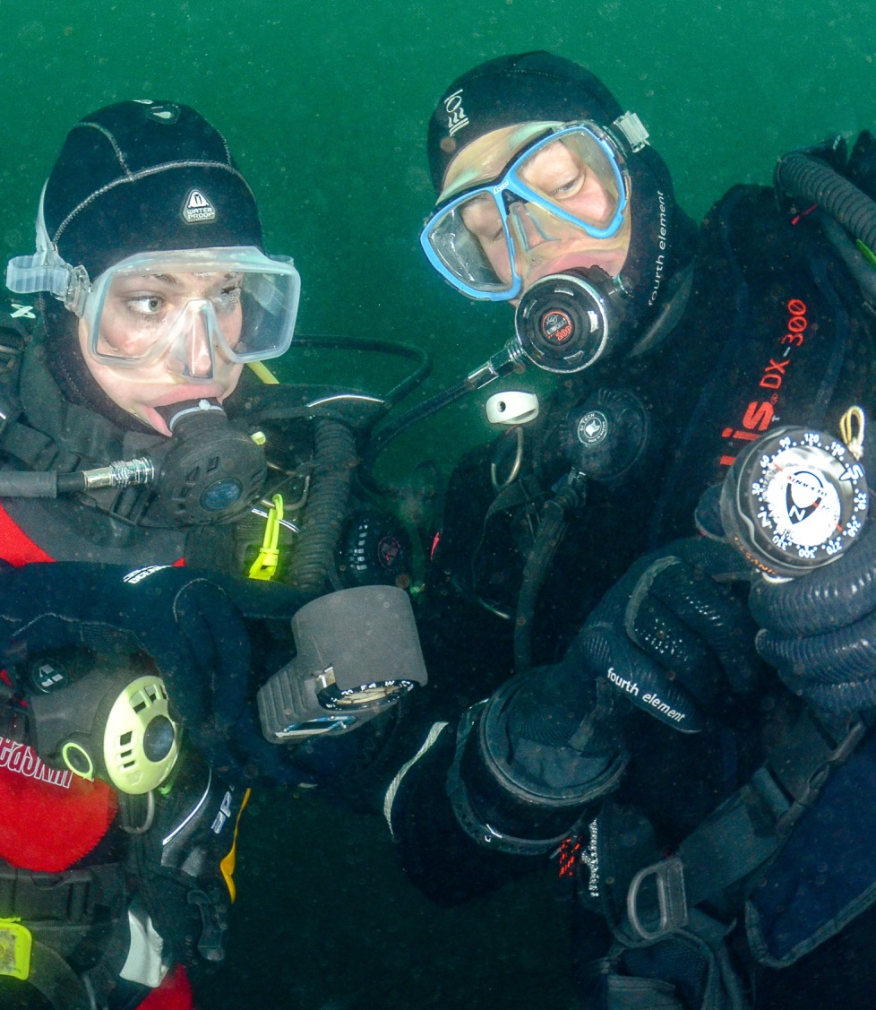
On reaching the bottom
Trim buoyancy
  Aim to hover
Check
  Buddy with you and OK
  Check breathing gas for self and buddy
  Look at buddy, all kit still in place and done up?
  Look for streams of bubbles
  Ask am I happy to continue?
  Establish direction of travel

Slide 17
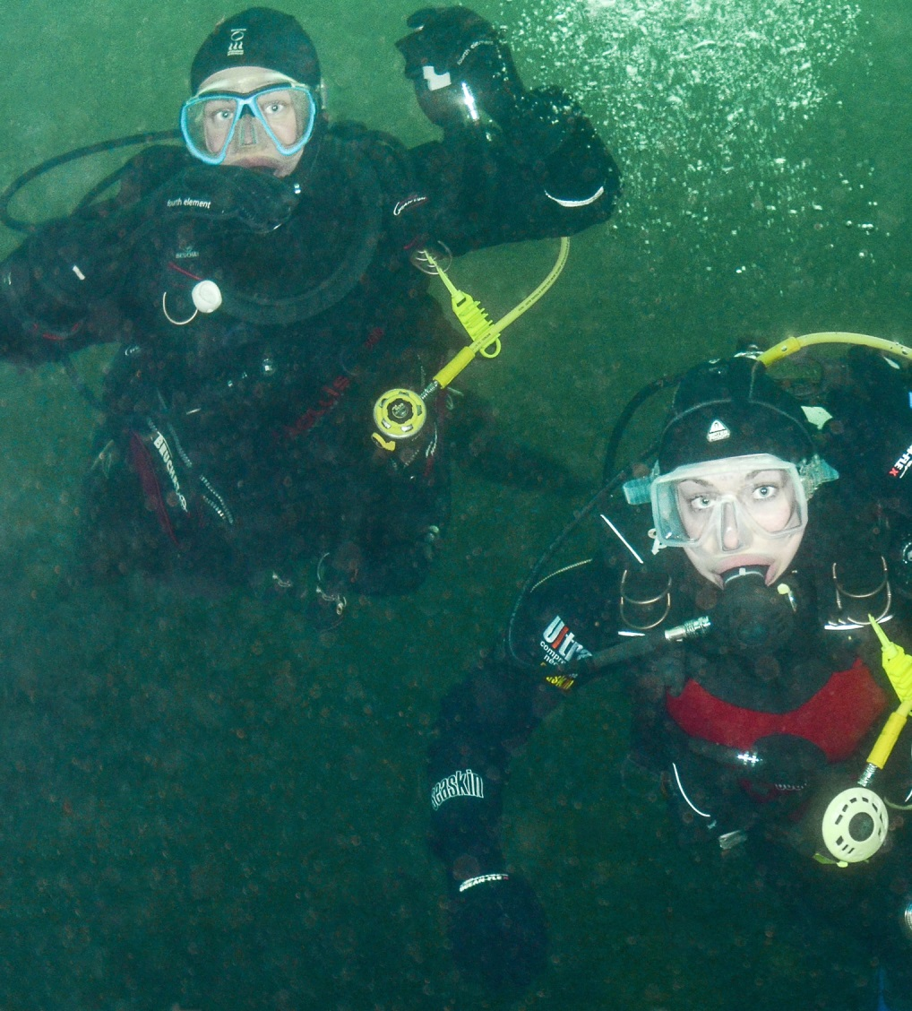
During the dive
Stay together
Monitor
  Conditions
  Depth
  Route
  Breathing gas
  Buddy
  Check alternative supply
  Weight belt feels OK?
Keep to plan
  If unhappy, abort the dive

Slide 18
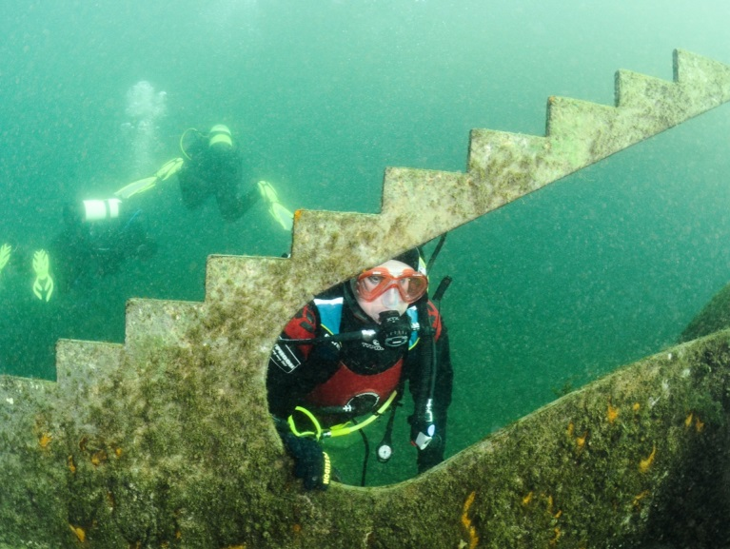
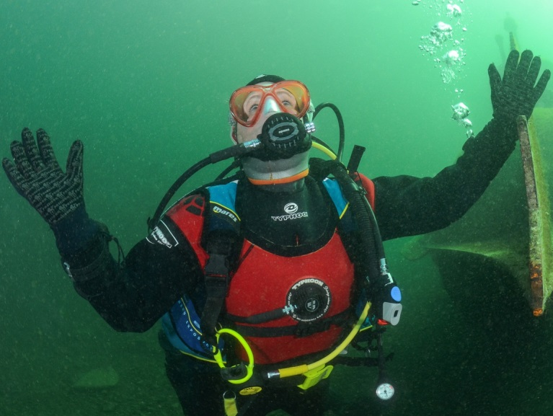
Separation procedure
If separated from your buddy
  Stop
  Focus on direction of last contact, look around and up
    30-60 seconds max
  Ascend
  At surface make yourself buoyant and await instructions from dive leader or DM
Trio diving
  Increased risk
  Buddy monitoring
  Self-reliance

Slide 19
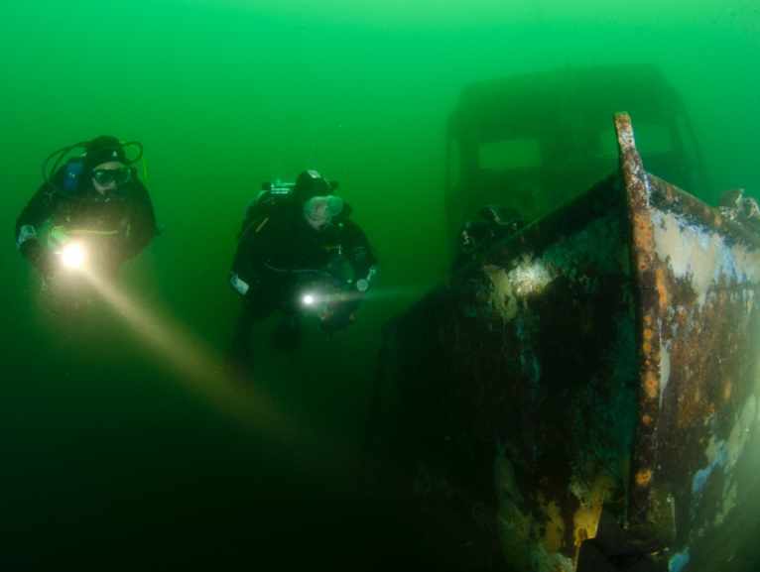
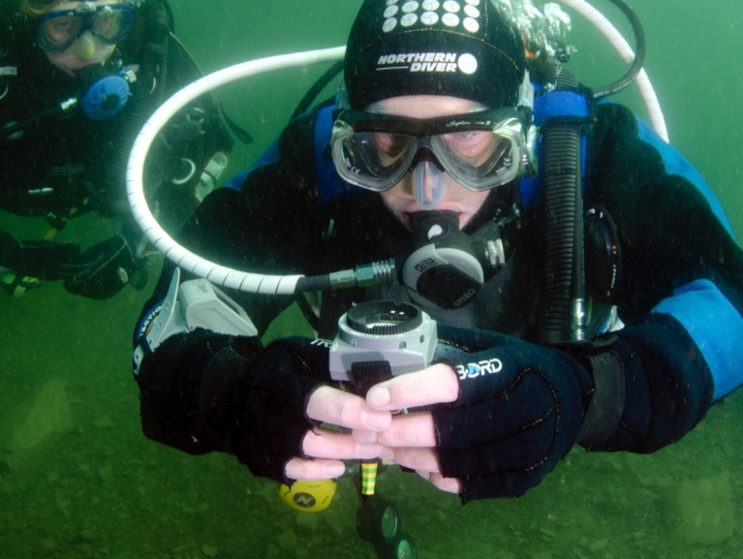
Finding your way
Pilotage
  Mental map underwater features on outward journey for the return
  Monitor depth
Compass
  Your instructor or buddy may a use compass to navigate
  A Sport Diver skill

Slide 20
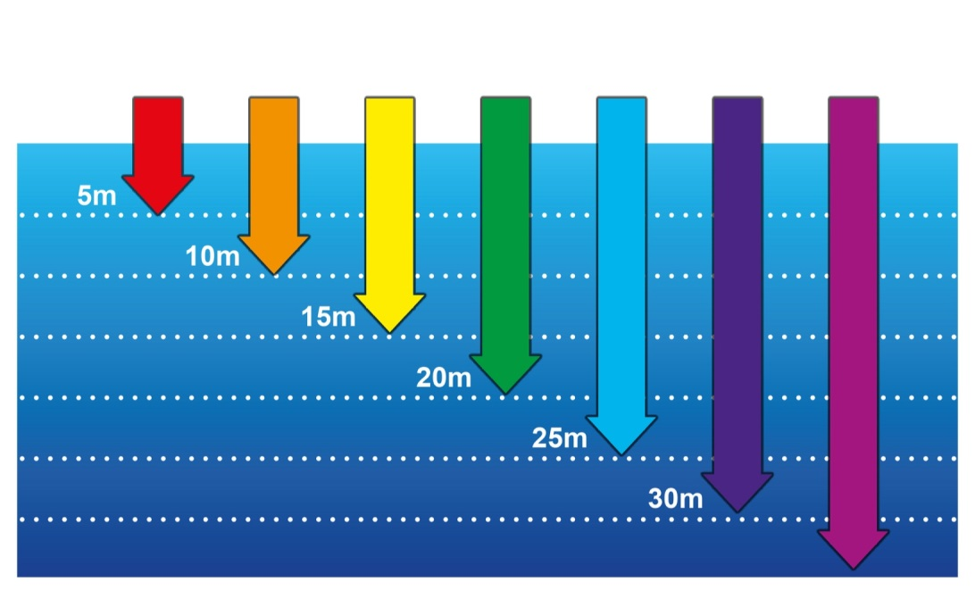
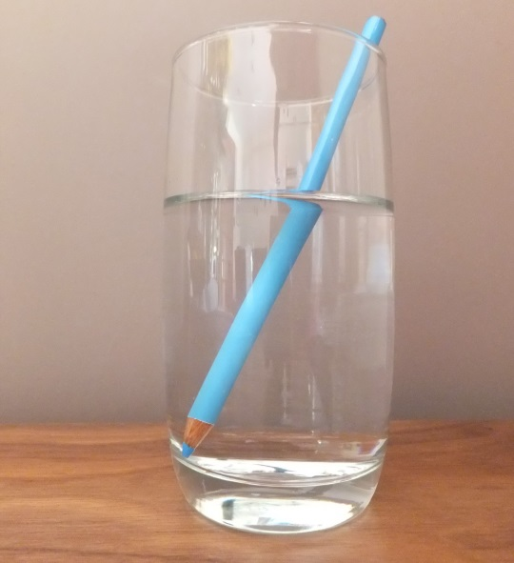
The environment underwater
Light
  Colour
  Visibility
  Magnification
Sound
  Speed
  Direction
Temperature
  Thermoclines

Slide 21
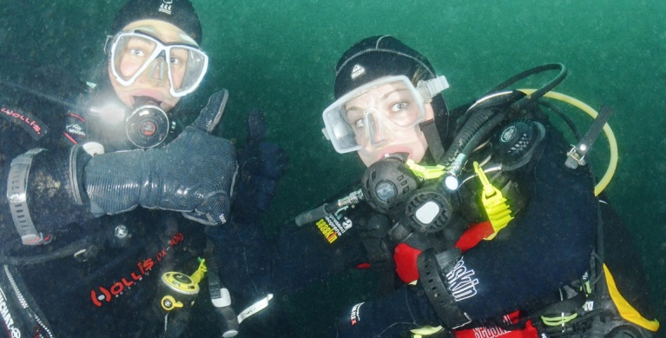
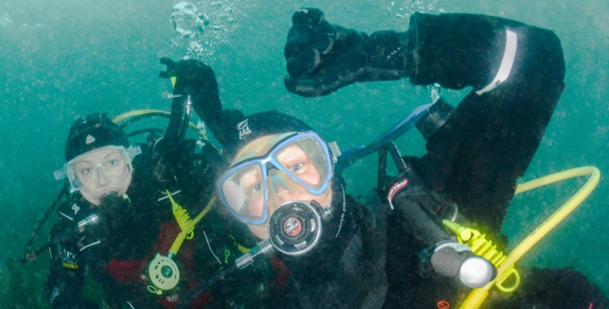
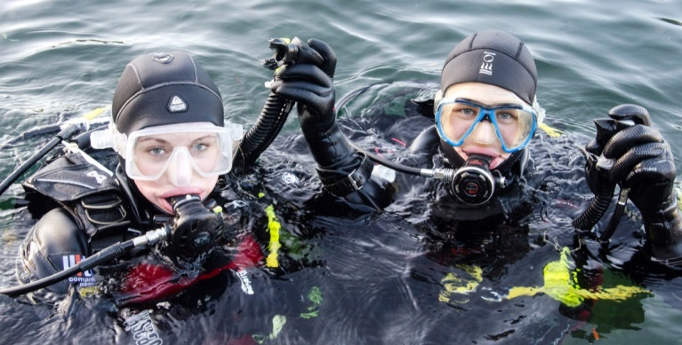
The ascent
Start ascent
  OK/Up
  Buoyancy control
  Stay together
Control ascent
  6m check depth
  Buoyancy control
  Controlled 1 min ascent to surface
Surface actions
  Inflate BC
  Signal OK to buddy
  Signal OK to surface cover
  Keep demand valve in mouth

Slide 22
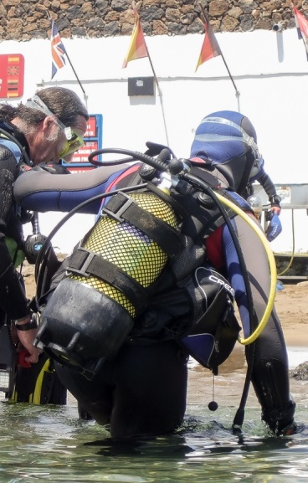
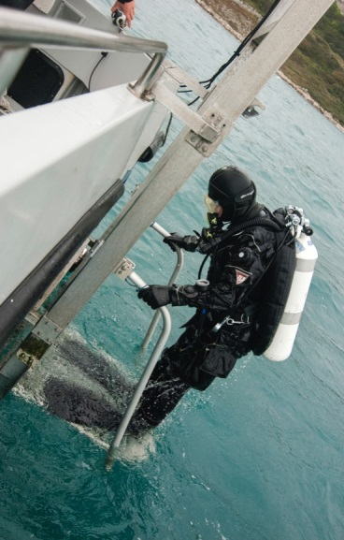
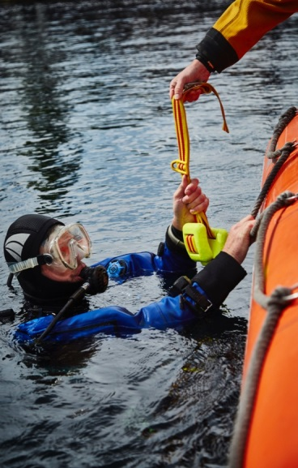
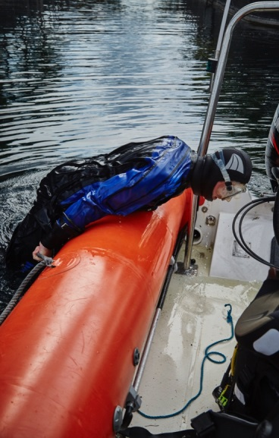
Exiting the water
Shelving shore
  Wade out
  Assist with fin removal
Large boat, some shores
  Steps or ladder
  Mask on, demand valve in, gas in BC
  Stay clear of diver on ladder/lift
Small boat
  Remove weight belt
  Remove scuba equipment
  Fin up into boat

Slide 23
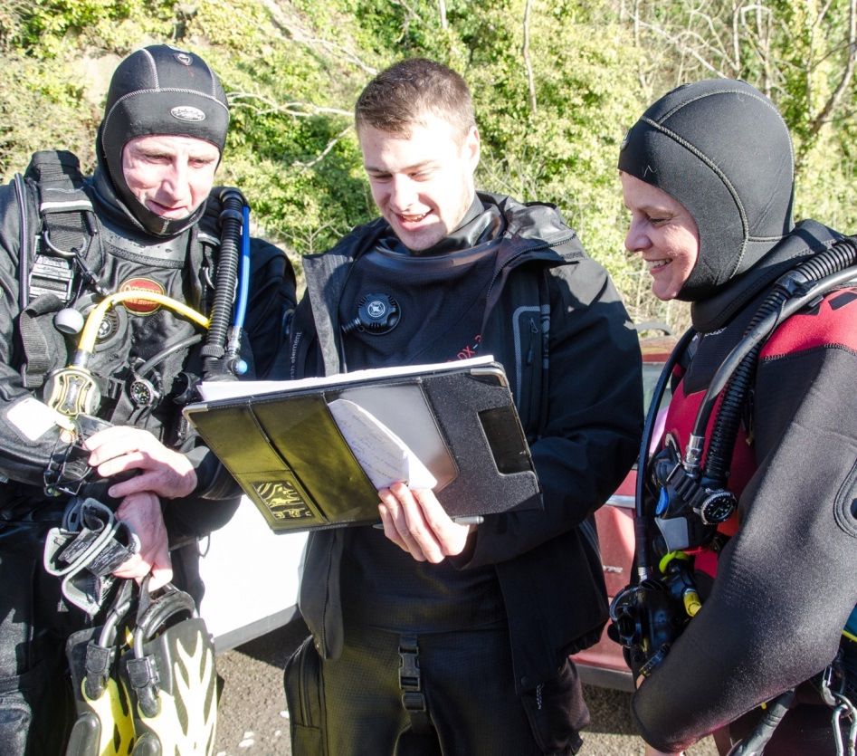
After the dive
Dive details
  To Dive Manager for branch/centre records
  For own dive logbook
  Record weight/kit used
Buddy dive debrief
  What you have seen
  What you have learnt or experienced
  Any areas for improvement/more practice
  Any kit configuration adaptations for future dives

Slide 24
Quiz 2
What are the responsibilities of the Dive Manager?
  Assessing risks
  Buddy pairings
  Diving grade and depth limitations
  Monitoring conditions
If separated from your buddy what should you do?
  Stop
  Focus on direction of last contact but look all around and up
  Ascend
  Make yourself buoyant and await instruction

Slide 25
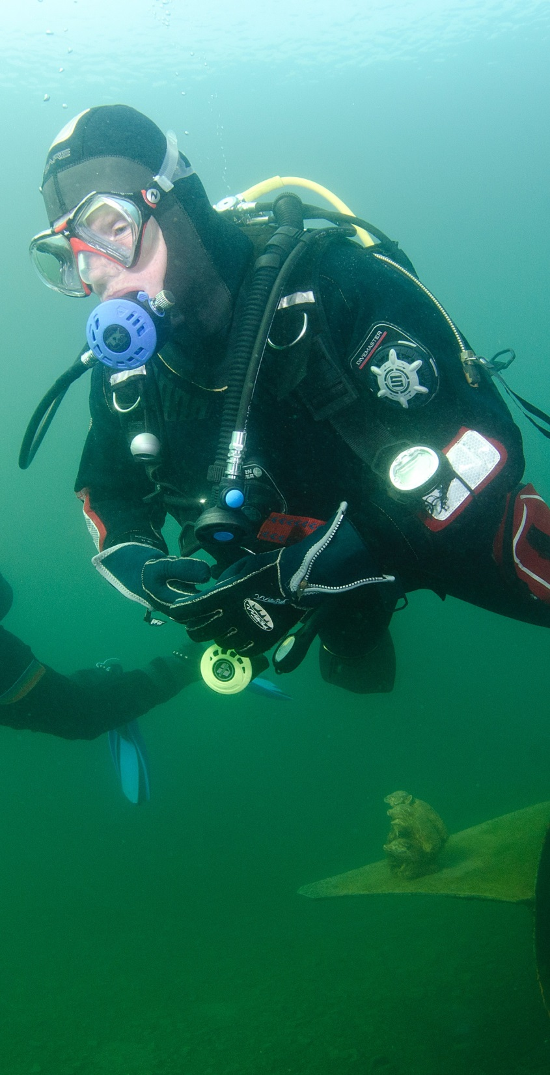

Summary
Module OT3
The practicalities of going diving
  Keeping safe
  Buddy diving
  Dive management
  Dive planning
  Diving signals
  Going on a dive
  The environment underwater

